Slide 1


Slide 2

18CSE354T – NETWORK SECURITY UNIT – 1
CLR-1: Understanding the Basic Concepts of Networking Devices
CLO-1: Acquire the knowledge of network devices used in data communication

Slide 3
Topics
Networking Devices (Layer1,2)
Networking Devices (Layer 3)
Different types of network layer attacks
Firewall- ACL
Packet Filtering
DMZ, Alerts
Audit Trials
IDS
Advantages and Disadvantages of IDS(Need of IPS)
Advantages of IPS over IDS
IPS
IPS Types- Signature based
Anomaly based, Policy based
IPS Types - Honeypot based
Applications
Malicious Software

Slide 4
SLO-1 Networking Devices (Layer 1, 2)
18CSE354T – NETWORK SECURITY S - 1 / UNIT - 1

Slide 5
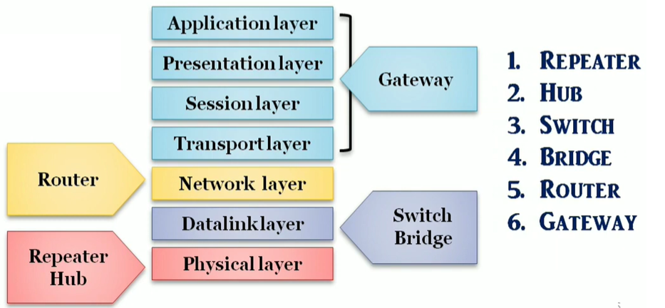
Networking Devices

Slide 6
Introduction
Information security is a set of practices intended to keep data secure from unauthorized access or alterations.
Computer security, the protection of computer systems and information from harm, theft, and unauthorized use.
Network security is a broad term that covers a multitude of technologies, devices and processes.
In its simplest term, it is a set of rules and configurations designed to protect the integrity, confidentiality and accessibility of computer networks and data using both software and hardware technologies.
18CSE354T – NETWORK SECURITY S - 1 / UNIT - 1

Slide 7
Network security for businesses and consumers
Network security should be a high priority for any organization that works with networked data and systems.
In addition to protecting assets and the integrity of data from external exploits, network security can also manage network traffic more efficiently, enhance network performance and ensure secure data sharing between employees and data sources.
18CSE354T – NETWORK SECURITY S - 1 / UNIT - 1

Slide 8
connecting devices?
LANs do not normally operate in isolation but they are connected to one another or to the Internet.
To connect LANs, connecting devices are needed and various connecting devices are such as bridge, switch, router, hub, repeater.
18CSE354T – NETWORK SECURITY S - 1 / UNIT - 1

Slide 9
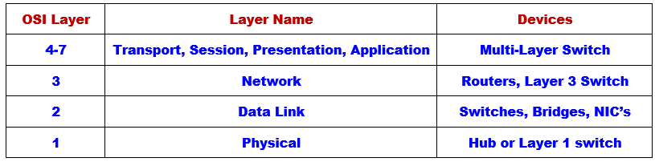
Network Devices & OSI Layer Association
18CSE354T – NETWORK SECURITY S - 1 / UNIT - 1

Slide 10
What is a network device?
Components used to connect computers as well as other electrical devices together in order to share resources such as printers and fax machines.
18CSE354T – NETWORK SECURITY S - 1 / UNIT - 1

Slide 11

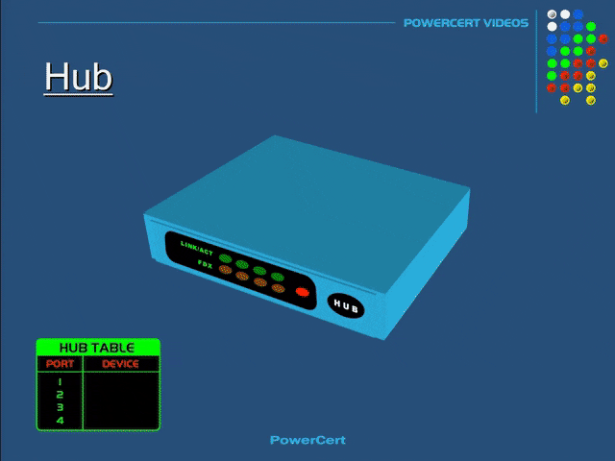
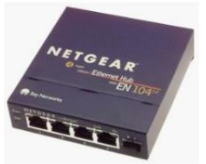
What is a Hub?
A small rectangular box that joins computers together through ports on the back of the hub.
Picture of a 4 – Port Ethernet Hub
18CSE354T – NETWORK SECURITY S - 1 / UNIT - 1

Slide 12
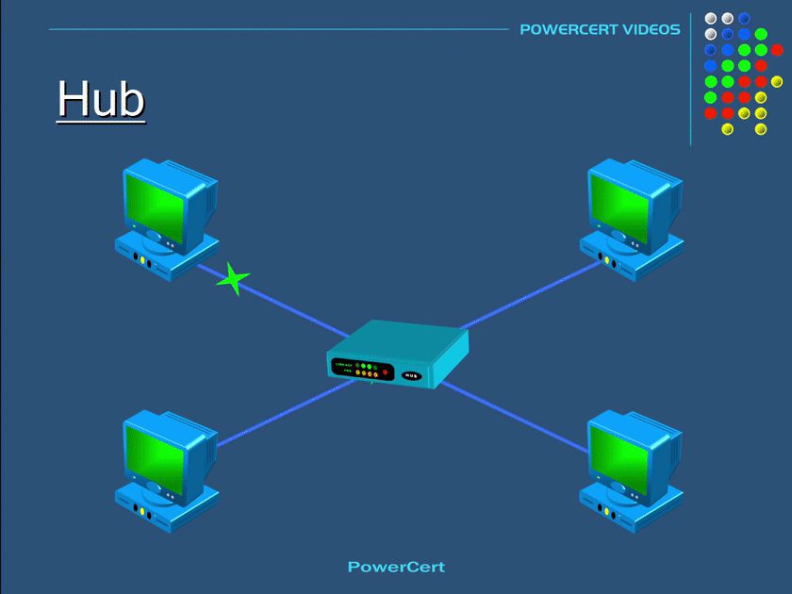

HUB
18CSE354T – NETWORK SECURITY S - 1 / UNIT - 1

Slide 13
How does a Hub work?
A hub receives data packets and passes on all the Information it receives to all the other computers connected to the hub.
Information is also sent to the computer that sent the information!
Example:
if computer 1 wants to communicate with computer 3, the data will be sent to all the computers on the network since hubs do not know the destination of the information it receives.
18CSE354T – NETWORK SECURITY S - 1 / UNIT - 1

Slide 14
HUB
HUB operated at Physical Layer is used to connect multiple computers in a single workgroup LAN network. Typically HUBs are available with 4,8,12,24,48 ports.
Based on port type, there are two types of HUB:-
Ethernet HUB :- In this type of HUB all ports have RJ-45 connectors.
Combo HUB :- In this type of HUB ports have several different types of connectors such RJ-45, BNC, and AUI.
18CSE354T – NETWORK SECURITY S - 1 / UNIT - 1

Slide 15
HUB
For Example a HUB which has four ports. Ports share everything.
One port received data signal from its connected device.
It will make three copies of data signal from HUB and give one copy to each port. Receiver port doesn’t need a copy of data signal for itself as it has it the original version.
18CSE354T – NETWORK SECURITY S - 1 / UNIT - 1

Slide 16
HUB
When a hub receives signal on its port, it repeats the signal and forwards that signal from all ports except the port on which the signal arrived
There are two types of HUB
Passive HUB:- It forwards the data signal from all ports
except the port on which signal arrived.
It doesn’t interfere in data signal.
Active HUB:- It also forwards the data signal from all
ports except the port on which signal arrived.
But before forwarding, it improves quality of data signal by amplifying it.
Due to this added features active HUB is also known as repeaters.
18CSE354T – NETWORK SECURITY S - 1 / UNIT - 1

Slide 17
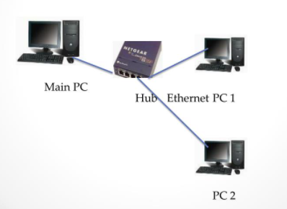
Diagram of a hub network
18CSE354T – NETWORK SECURITY S - 1 / UNIT - 1

Slide 18
Additional Information about Hubs
Most hubs contain 4 ports some have 5 or more ports.
Hubs can be used for a smaller network such as a home network or a small office network.
Hubs are not that expensive most range for less than $30.
Hubs may not be the best option for sophisticated or complex networks.
18CSE354T – NETWORK SECURITY S - 1 / UNIT - 1

Slide 19
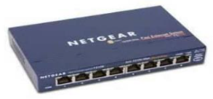
What is a Switch?
Switches look similar to hubs in that they are rectangular in shape.
Manageable switches are usually a little bigger than unmanageable switches.
A switch also has ports on the back.
18CSE354T – NETWORK SECURITY S - 1 / UNIT - 1

Slide 20
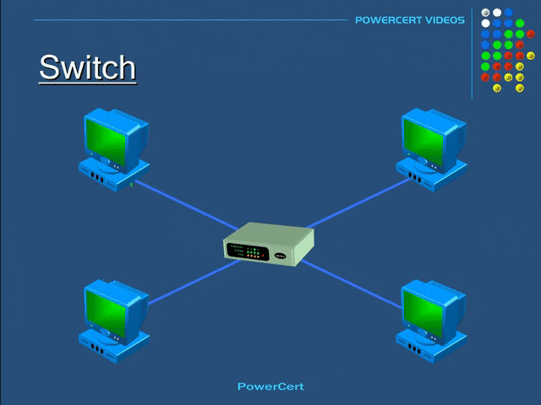
Switch
18CSE354T – NETWORK SECURITY S - 1 / UNIT - 1

Slide 21
How does a Switch work?
Switches work about the same way as hubs. Unlike hubs, switches can identify the destination of a packet.
Switches send information only to the computer that is suppose to receive the information.
Switches can also send and retrieve information at the same time which makes sending information faster to retrieve than hubs.
18CSE354T – NETWORK SECURITY S - 1 / UNIT - 1

Slide 22
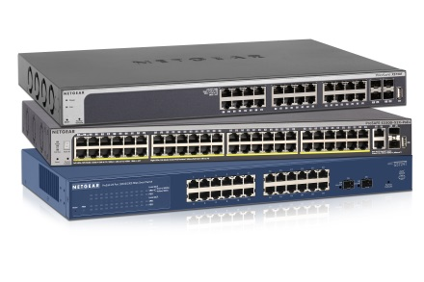
Switch
Just like Hub and Bridge, switch is also used to connect multiple computers together in a LAN segment.
Switch operates at data link layer
Switches available with 4,8,12,24,48,64 ports.
Each switch port has a separate collision domain.
At layer two data signals are formatted in frames.
When a switch receives frame, it checks FCS (Frame checksum sequence) field in it.
Switch process the frame only if it is valid.
All invalided frames are automatically dropped.
All valid frames are processed and forwarded to their destination MAC address
18CSE354T – NETWORK SECURITY S - 1 / UNIT - 1

Slide 23
Switch
Switches support three methods of switching
Store and Forward
Cut and Through
Fragment Free
Store and Forward
This is the basic mode of switching. In this mode Switch buffers entire frame into the memory and run FCS (Frame Check Sequence) to ensure that frame is valid and not corrupted.
A frame less than 64 bytes and higher than 1518 bytes is invalid.
Only valid frames are processed and all invalid frames are automatically dropped.
Among these three methods, this method has highest latency.
Latency is the time taken by device in passing frame from it.
18CSE354T – NETWORK SECURITY S - 1 / UNIT - 1

Slide 24
Switch
Cut and Through
Cut and Through method has lowest latency.
In this method Switch only read first six bytes from frame after the preamble. These six bytes are the destination address of frame.
This is the fastest method of switching.
This method also process invalid frames.
Only advantage of this method is speed.
18CSE354T – NETWORK SECURITY S - 1 / UNIT - 1

Slide 25
Switch
Fragment Free
This is a hybrid version of Store and Forward method and Cut and Through method.
It takes goodies from both methods and makes a perfect method for switching.
It checks first 64 bytes of frame for error. It processes only those frames that have first 64bytes valid.
Any frame less than 64 bytes is known as runt. Runt is an invalid frame type.
This method filters runt while maintaining the speed.
18CSE354T – NETWORK SECURITY S - 1 / UNIT - 1

Slide 26
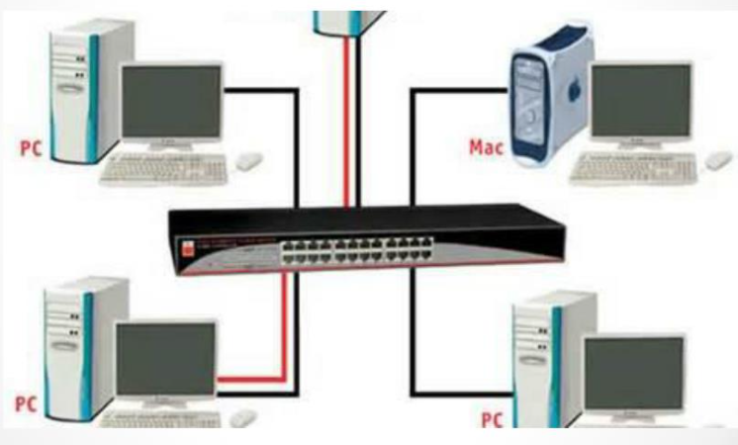
Diagram of a Switch Network
18CSE354T – NETWORK SECURITY S - 1 / UNIT - 1

Slide 27
Additional Information about Switches
Switches are a better option than hubs for larger networks or home networks with 4 or more connected computers.
Switches can range in price from $30 up to $100 or more depending on if the switch is manageable or unmanageable, usually unmanageable switches are less in price versus managed switches
18CSE354T – NETWORK SECURITY S - 1 / UNIT - 1

Slide 28
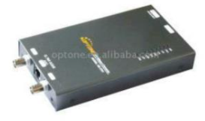
What is a Bridge?
A hardware device used to create a connection between two separate computer networks or to divide one network into two.
Filters data traffic at a network boundary and reduces the amount of traffic on a LAN dividing it into two segments.
18CSE354T – NETWORK SECURITY S - 1 / UNIT - 1

Slide 29
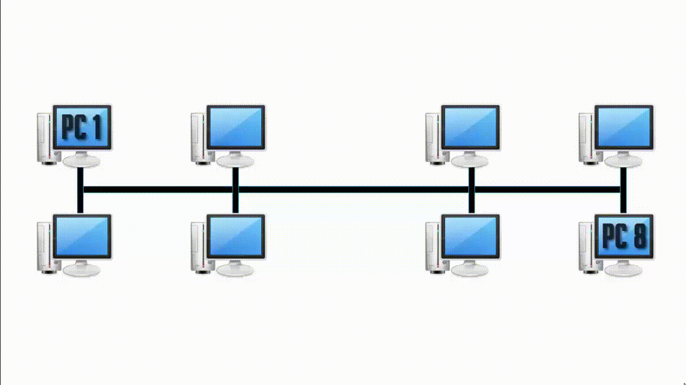
Bridge
Bridge in networking divides a LAN into multiple segments. Bridge basically works in a bus topology.
In bus topology the time PC 1 wants to send data to PC 8, it broadcast the data to all the connected devices in a network and like this, it creates lots of traffic.
So, from overcoming this problem we are using a networking device bridge.
18CSE354T – NETWORK SECURITY S - 1 / UNIT - 1

Slide 30
How does a Bridge work?
Each bridge consist of a MAC address and operates at layer 2 of the OSI model
When a packet is received on the bridge ports the forwarding table including the MAC address is automatically updated to map the source MAC address to the network port from which the packet originated
The gateway then process the received packet according to the packet’s type.
18CSE354T – NETWORK SECURITY S - 1 / UNIT - 1

Slide 31
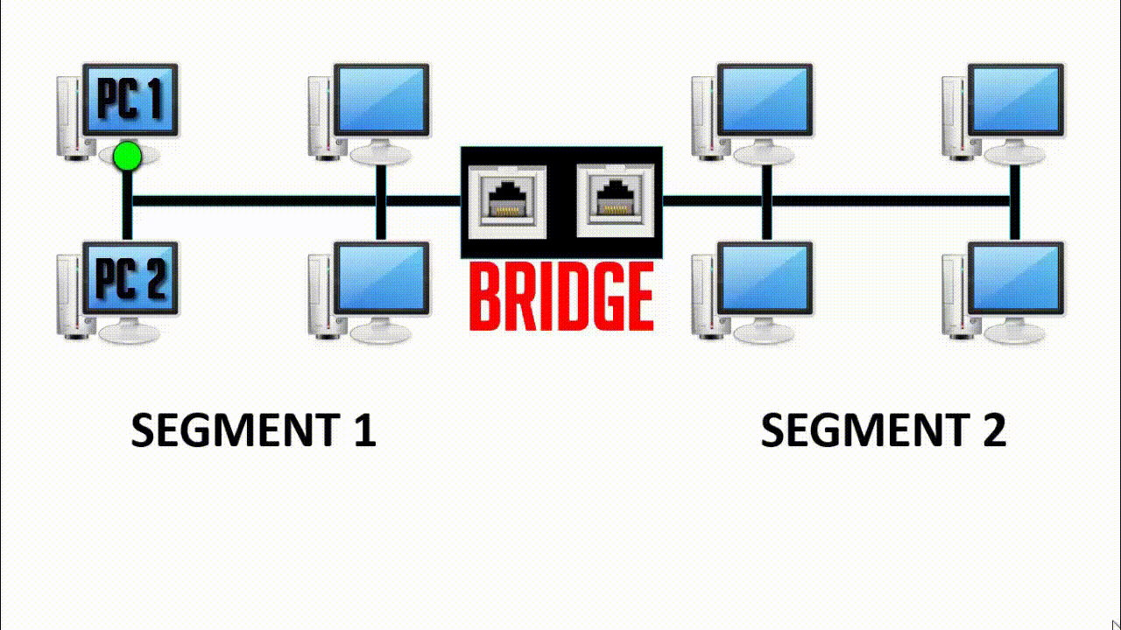
How Bridge works in Network
Bridge in networking divides a LAN into two segments (Segment 1 and Segment 2) and stores all the connected PC’s MAC address into its table.
Let’s take an example, Here PC 1 tries to send data to PC 2. Data will first travel to the bridge. The bridge will read its MAC address and decide whether to send the data to segment 1 or segment 2.
Hence, the PC 2 is available in segment 1 means bridge will broadcast the data only in segment 1 and excludes all the PCs connected in segment 2. Like this bridge reduce the traffic on a computer network.
18CSE354T – NETWORK SECURITY S - 1 / UNIT - 1

Slide 32
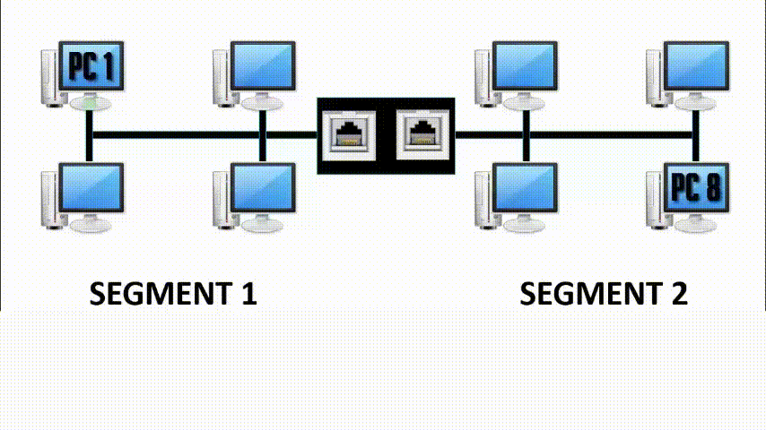
Bridge
Let’s take one more example. As mentioned in the above picture, PC 1 is trying to send data to PC 8. So, the data will first travel to the bridge.
The bridge is going to read it’s MAC Address table and find whether PC 8 belongs to Segment 1 or Segment 2.
Hence, the PC 8 is in segment 2 bridge will broadcast the data in segment 2 and excludes all the PCs connected to Segment 1.
So, this is how the bridge works and reduce traffic in a computer network.
18CSE354T – NETWORK SECURITY S - 1 / UNIT - 1

Slide 33
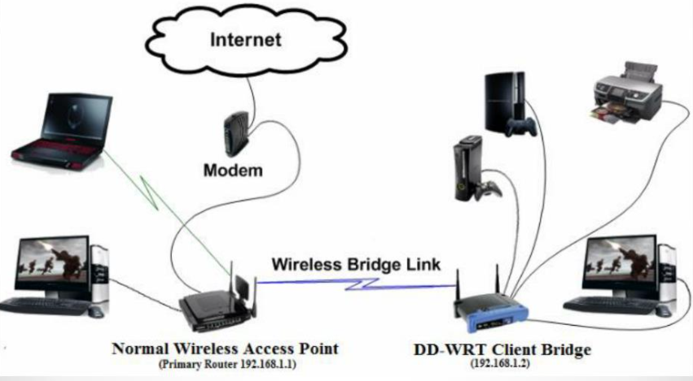
Diagram of a Bridge
18CSE354T – NETWORK SECURITY S - 1 / UNIT - 1

Slide 34
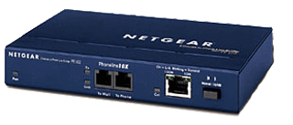
Bridge
Bridge operates at data link layer
It is used to divide a large network in smaller segments.
For example a network has 70 nodes.
Without segmentation all these nodes will share same collision domain that will bring down overall network performance.
To run a network smoothly we should not place more than 20 nodes in a collision domain.
To deal with this situation we can use Bridge.
Bridge has per port collision domain which means if a port faces collision, other ports will not effect from this collision
18CSE354T – NETWORK SECURITY S - 1 / UNIT - 1

Slide 35
Bridge
Basic function of Bridge are following :-
Break a large network in smaller segments.
Join different media types such as UTP with fiber optic.
Join different network architectures such as Ethernet with Token Ring
There are three types of bridge:-
Local Bridge :
This bridge connects two LAN segments directly.
In Ethernet Implementation it is known as Transparent bridge. In Token Ring network it is called Source-Routed bridge
18CSE354T – NETWORK SECURITY S - 1 / UNIT - 1

Slide 36
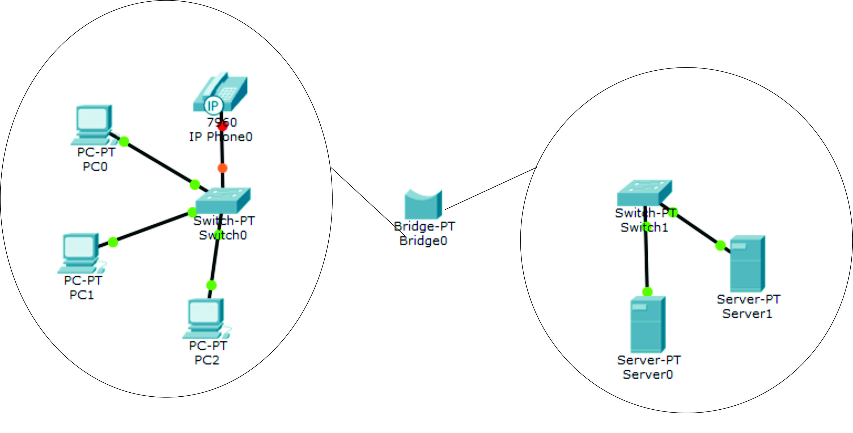
Bridge
18CSE354T – NETWORK SECURITY S - 1 / UNIT - 1

Slide 37
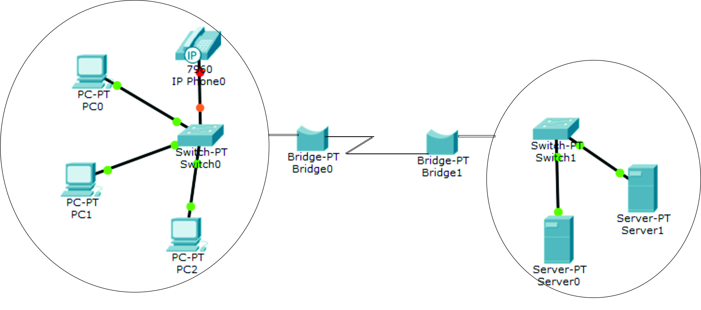
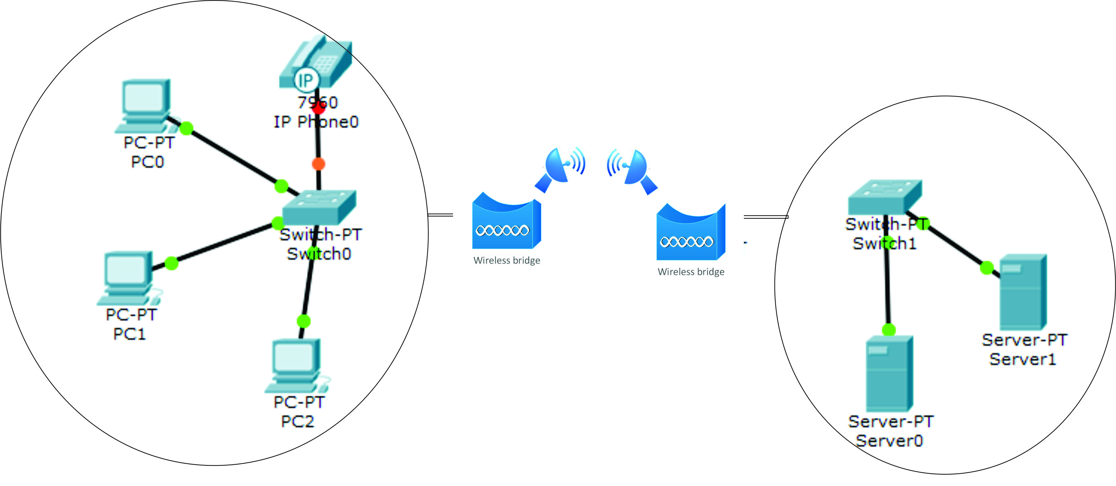
Bridge
Remote Bridge:
This bridge connects with another bridge over the WAN link.
Wireless Bridge: This bridge connects with another bridge without wiring between them.
18CSE354T – NETWORK SECURITY S - 1 / UNIT - 1

Slide 38

Bridge
Bridges have following issues :-
Bridges have limited ports
In bridge forward decision are made through the software which slow down overall performance of network
Bridges use age old technology which is not capable to fulfill the requirement of modern networks effectively
Switch and Router solves these issues
18CSE354T – NETWORK SECURITY S - 1 / UNIT - 1

Slide 39
Additional Information about Bridges
A bridge examines each message on a LAN and passes the ones known to be within the same LAN.
Computer addresses have no relationship to location in a bridging network.
A bridge is sometimes referred to as a brouter.
Wireless network bridges can costs anywhere from $100 to $1000 or more depending on the type of bridge purchased.
18CSE354T – NETWORK SECURITY S - 1 / UNIT - 1

Slide 40
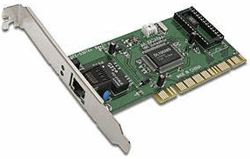
Network Interface Card (NIC)
NIC stands on first place. Without this device, networking cannot be done.
This is also known as network adapter card, Ethernet Card and LAN card
A PC uses parallel data transmission technology to transmit data between its internal parts while the media that connects this PC with other PCs uses serial data transmission technology
A NIC converts parallel data stream into serial data stream and vice versa serial data stream is get converted in parallel data stream.
18CSE354T – NETWORK SECURITY S - 1 / UNIT - 1

Slide 41
Types of NICs
There are two types of NICs
Media Specific :
Different types of NICs are required to connect with different types of media.
For example we cannot connect wired media with wireless NIC card.
Just like this, we cannot connect coaxial cable with Ethernet LAN card. We have to use the LAN card that is particularly built for the media type which we have.
Network Design Specific :
A specific network design needs a specific LAN card.
For example FDDI(Fiber Distributed Data Interface), Token Ring and Ethernet have their own distinctive type of NICs card. They cannot use other’s NIC card.
18CSE354T – NETWORK SECURITY S - 1 / UNIT - 1

Slide 42
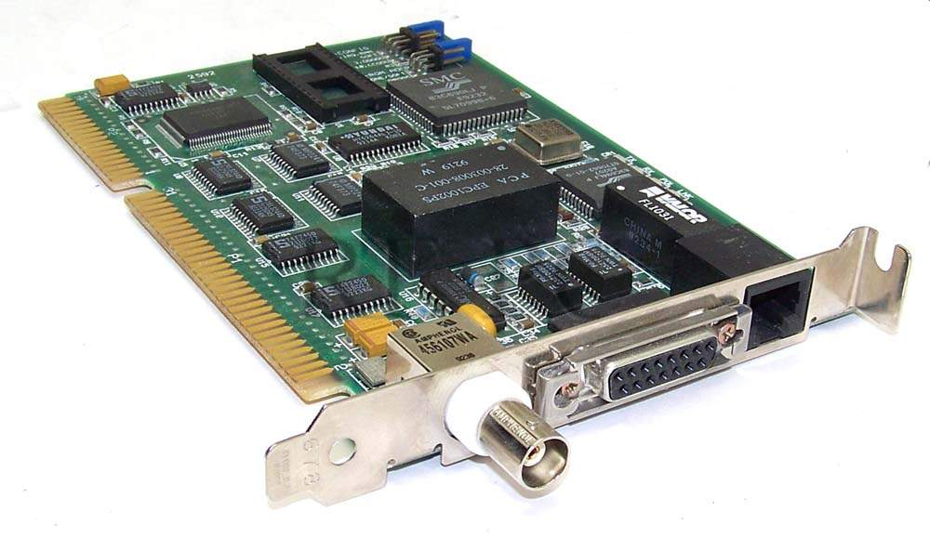
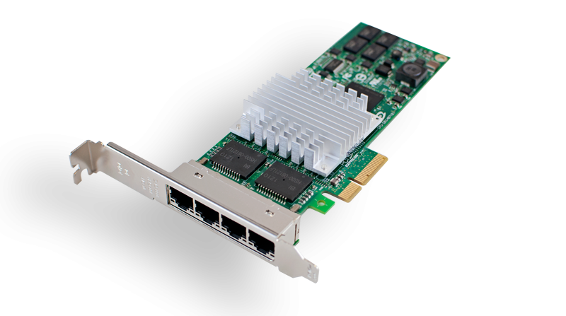
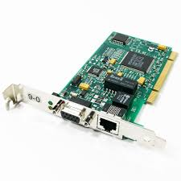
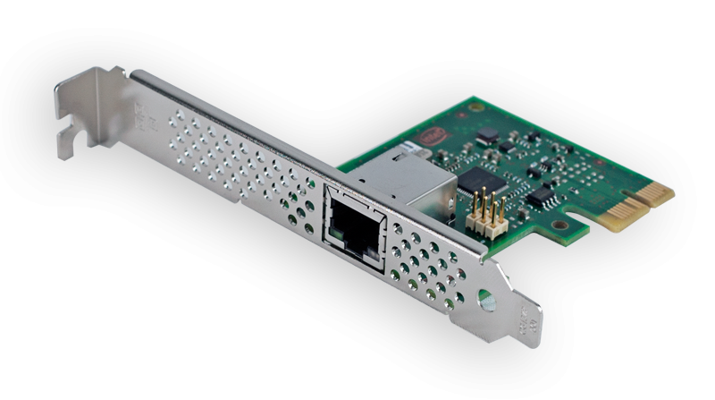
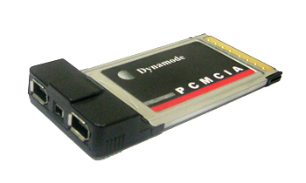
NIC
1 BNC and 1 RJ45 NIC
4 RJ45 NIC
Token Ring NIC
Single RJ45 NIC
PCMCIA for Laptops
18CSE354T – NETWORK SECURITY S - 1 / UNIT - 1

Slide 43
Repeater
Repeater – A repeater operates at the physical layer.
Its job is to regenerate the signal over the same network before the signal becomes too weak or corrupted so as to extend the length to which the signal can be transmitted over the same network.
An important point to be noted about repeaters is that they do not amplify the signal.
When the signal becomes weak, they copy the signal bit by bit and regenerate it at the original strength. It is a 2 port device.
18CSE354T – NETWORK SECURITY S - 1 / UNIT - 1

Slide 44
SLO - 2 Networking Devices (Layer 3)
18CSE354T – NETWORK SECURITY S - 1 / UNIT - 1

Slide 45
What is a Router?
A specialized computer programmed to interface between different networks
18CSE354T – NETWORK SECURITY S - 1 / UNIT - 1

Slide 46
How does a Router work?
A router receives data from the user.
Looks for the remote address of the other computer making routing decisions along the way
Forwards the user data out to a different interface that is closer to the remote computer
18CSE354T – NETWORK SECURITY S - 1 / UNIT - 1

Slide 47
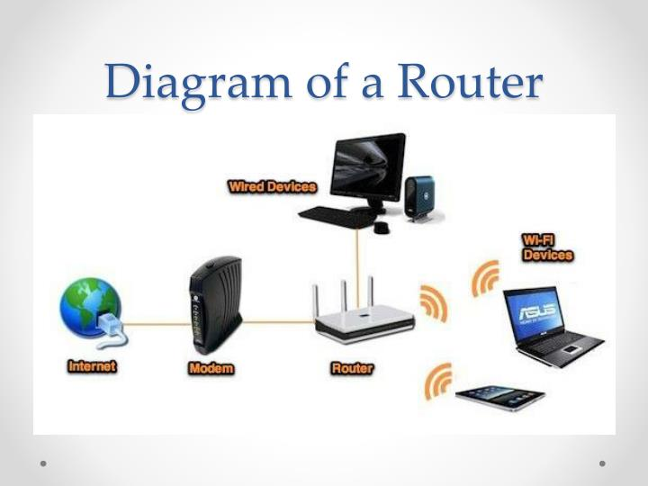
Diagram of a Router
18CSE354T – NETWORK SECURITY S - 1 / UNIT - 1

Slide 48
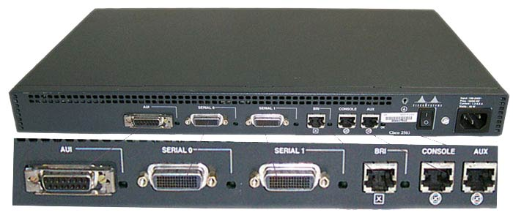
Router
Router is a layer three device operates at Network Layer which forwards data packet from one logical network segment to another.
Router forwards packets on the bases of their destination address. For this router keeps record of the path that packets can use as they move across the network.
These records are maintained in a database table known as routing table.
Routing table can be built statically or dynamically
18CSE354T – NETWORK SECURITY S - 1 / UNIT - 1

Slide 49
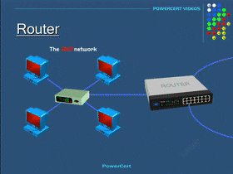
Router
18CSE354T – NETWORK SECURITY S - 1 / UNIT - 1

Slide 50
Router
Basically routers are used :-
To connect different network segments.
To connect different network protocols such as IP and IPX.
To connect several smaller networks into a large network (known as internetwork)
To break a large network in smaller networks (Known as subnet usually created to improve the performance or manageability)
To connect two different media types such as UTP and fiber optical.
To connect two different network architectures such as token ring and Ethernet.
To connect LAN network with Telco company’s office (Known as DTE device).
To access DSL services (known as DSL Router).
18CSE354T – NETWORK SECURITY S - 1 / UNIT - 1

Slide 51
Additional Information about Routers
Routers make sure data sent over the Internet goes where it needs to go and not where it is not needed.
Acts like a traffic controller, working to cut down congestion throughout the network and keeps everything flowing smoothly along the best path.
Routers are the only type of equipment that looks at every single packet passing by on the network.
Home network router including wireless routers can cost anywhere from $40 to $150 or higher.
18CSE354T – NETWORK SECURITY S - 1 / UNIT - 1

Slide 52
Repeater
A repeater operates at the physical layer.
Its job is to regenerate the signal over the same network before the signal becomes too weak or corrupted so as to extend the length to which the signal can be transmitted over the same network.
An important point to be noted about repeaters is that they do not amplify the signal.
When the signal becomes weak, they copy the signal bit by bit and regenerate it at the original strength. It is a 2 port device.
18CSE354T – NETWORK SECURITY S - 1 / UNIT - 1

Slide 53
What is a Gateway?
A communication device that provides a remote network with connectivity to the host network.
18CSE354T – NETWORK SECURITY S - 1 / UNIT - 1

Slide 54
How a Gateway Works
The gateway node acts like a proxy server and firewall
The gateway uses forwarding tables to determine where packet are to be sent
18CSE354T – NETWORK SECURITY S - 1 / UNIT - 1

Slide 55
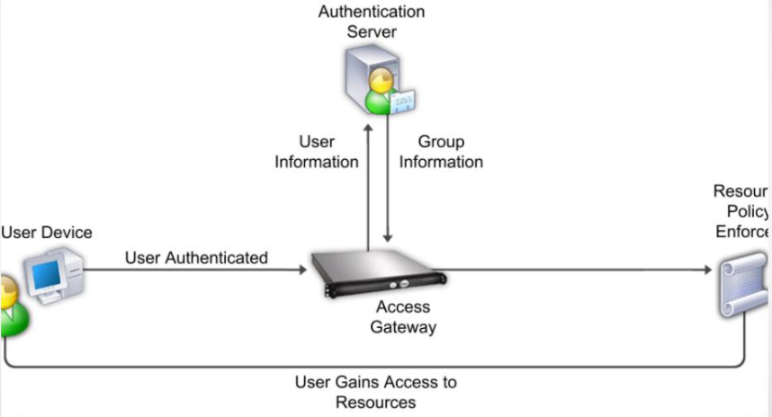
Gateway Diagram
18CSE354T – NETWORK SECURITY S - 1 / UNIT - 1

Slide 56
Gateway
Gateway –
A gateway, as the name suggests, is a passage to connect two networks together that may work upon different networking models.
They basically work as the messenger agents that take data from one system, interpret it, and transfer it to another system.
Gateways are also called protocol converters and can operate at any network layer. Gateways are generally more complex than switch or router.
Brouter –
It is also known as bridging router is a device which combines features of both bridge and router.
It can work either at data link layer or at network layer.
Working as router, it is capable of routing packets across networks and working as bridge, it is capable of filtering local area network traffic.
18CSE354T – NETWORK SECURITY S - 1 / UNIT - 1

Slide 57
Additional Information about Gateways
On the Internet a node or stopping point can be a gateway.
The computers controlling traffic within a network are gateway nodes.
A gateway is also associated with a router.
18CSE354T – NETWORK SECURITY S - 1 / UNIT - 1

Slide 58
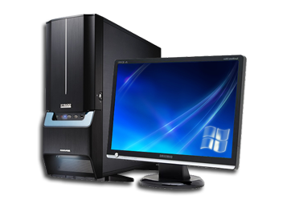
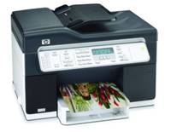


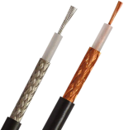


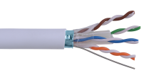

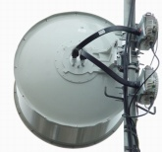
Definition of Computer Networks
A Computer networks is a collection of nodes or computers or systems and devices connected together through communication devices and transmission media
Guided Media
Wireless Media
18CSE354T – NETWORK SECURITY S - 1 / UNIT - 1

Slide 59
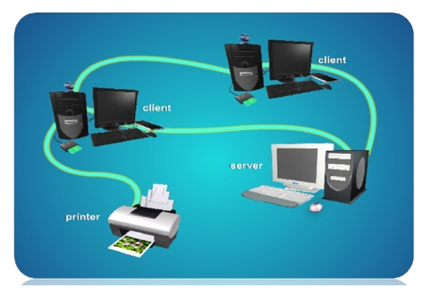
Computer Communications
Communication describes a process in which two or more computer or devices transfer data, instructions and information.
18CSE354T – NETWORK SECURITY S - 1 / UNIT - 1

Slide 60
Advantages of Networks
Sharing of devices such as printer and scanner
Sharing of program/ software
Sharing of files
Sharing of data
Sharing of information
Sharing of single high-speed Internet connection
Can access server centered database
Better communication using internet services such as email, mailing list and Internet Relay Chat(IRC)
18CSE354T – NETWORK SECURITY S - 1 / UNIT - 1

Slide 61
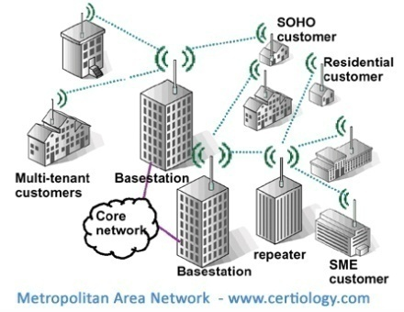
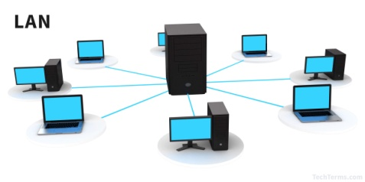
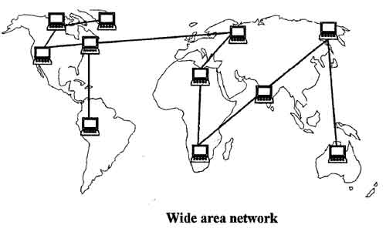
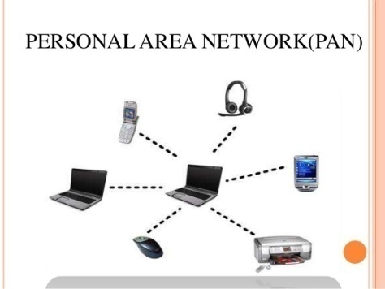
Different Types of Networks
Depending upon the geographical area covered by a network, it is classified as :
Local Area Network (LAN)
Metropolitan Area Network (MAN)
Wide Area Network (WAN)
Personal Area Network (PAN)
18CSE354T – NETWORK SECURITY S - 1 / UNIT - 1

Slide 62
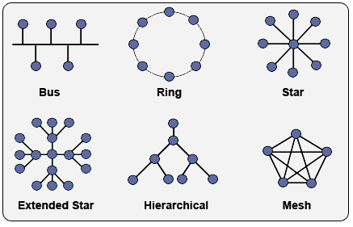
Topologies
18CSE354T – NETWORK SECURITY S - 1 / UNIT - 1

Slide 63
Physical and Logical LAN topology
Physical
The geometric arrangement of components that make up the LAN
Logical
The possible connections between pairs of networked end-points that can communicate
18CSE354T – NETWORK SECURITY S - 1 / UNIT - 1

Slide 64
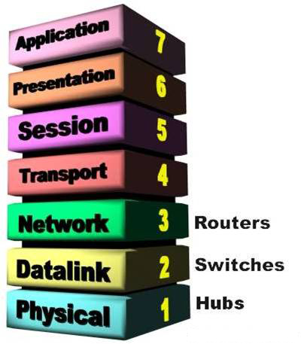
OSI Layers
18CSE354T – NETWORK SECURITY S - 1 / UNIT - 1

Slide 65
Seven Layers of OSI
File Transfer, Email, Remote Login →
ASCII Text, Sound (syntax layer) →
Establish/manage connection →
End-to-end control & error checking
(ensure complete data transfer): TCP →
Routing and Forwarding Address: IP →
Two party communication: Ethernet →
How to transmit signal; coding Hardware
means of sending an receiving data on a → carrier
18CSE354T – NETWORK SECURITY S - 1 / UNIT - 1

Slide 66
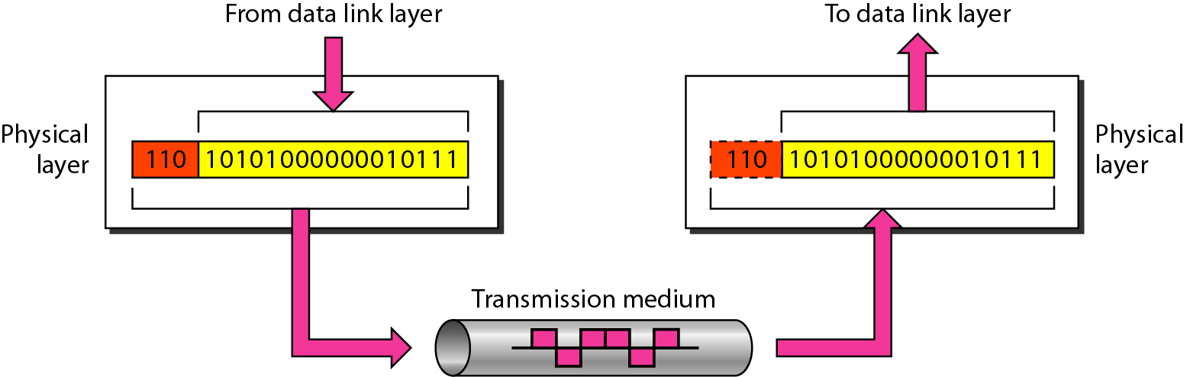
Physical layer
The physical layer is responsible for movements of
individual bits from one hop (node) to the next.
18CSE354T – NETWORK SECURITY S - 1 / UNIT - 1

Slide 67
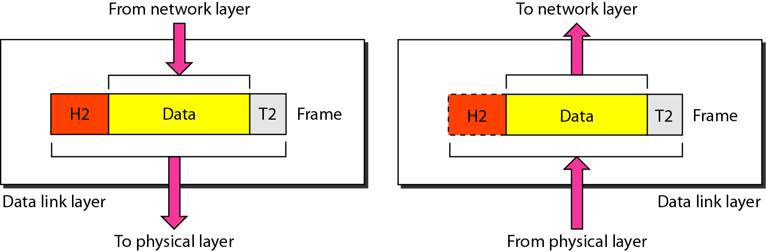
Data link layer
The data link layer is responsible for moving frames from one hop (node) to the next.
18CSE354T – NETWORK SECURITY S - 1 / UNIT - 1

Slide 68
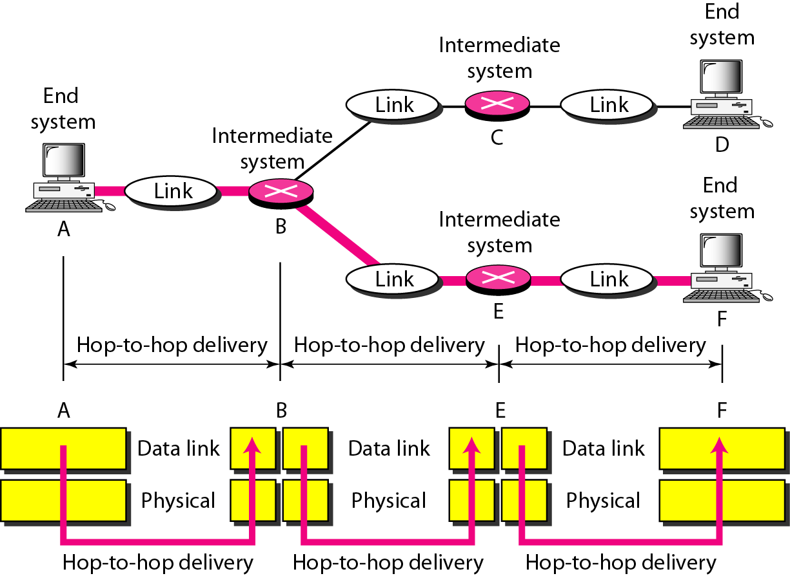
Hop-to-hop delivery
18CSE354T – NETWORK SECURITY S - 1 / UNIT - 1

Slide 69
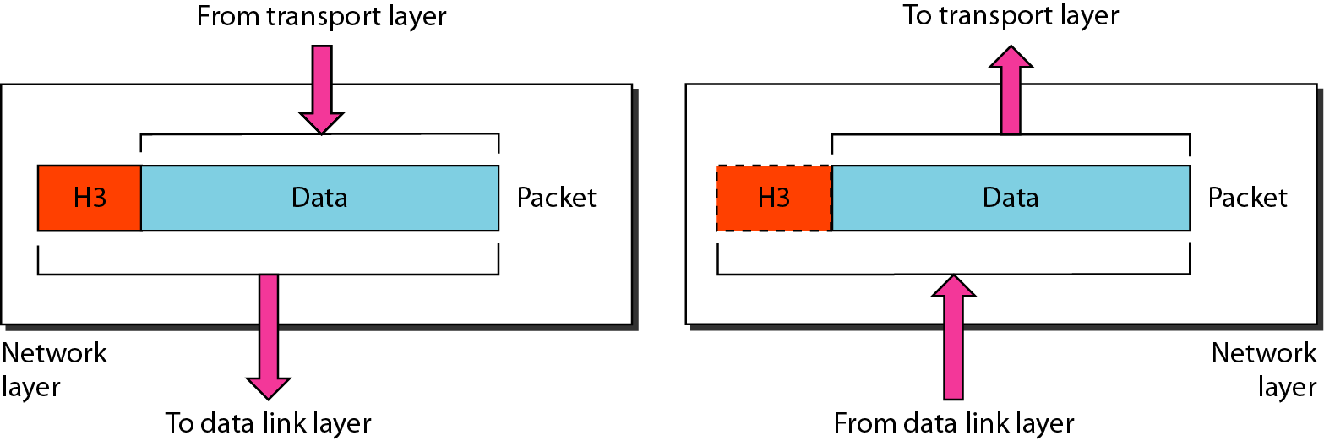
Network layer
The network layer is responsible for the delivery of individual packets from
the source host to the destination host.
18CSE354T – NETWORK SECURITY S - 1 / UNIT - 1

Slide 70
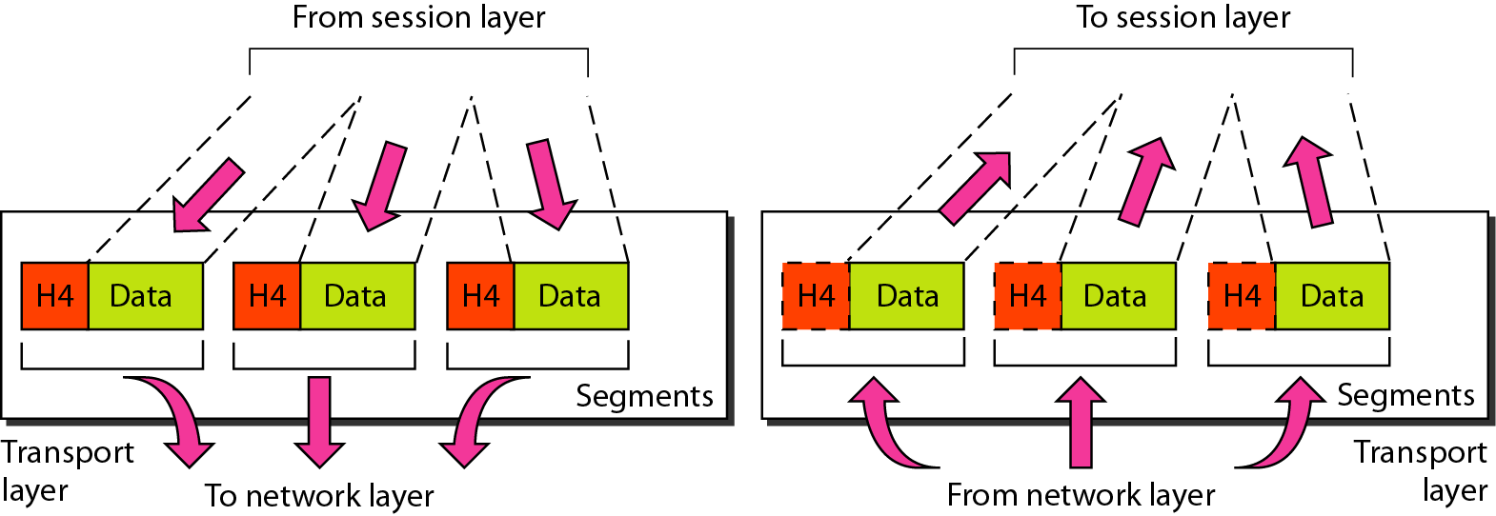
Transport layer
The transport layer is responsible for the delivery of a message from one process to another.
18CSE354T – NETWORK SECURITY S - 1 / UNIT - 1

Slide 71
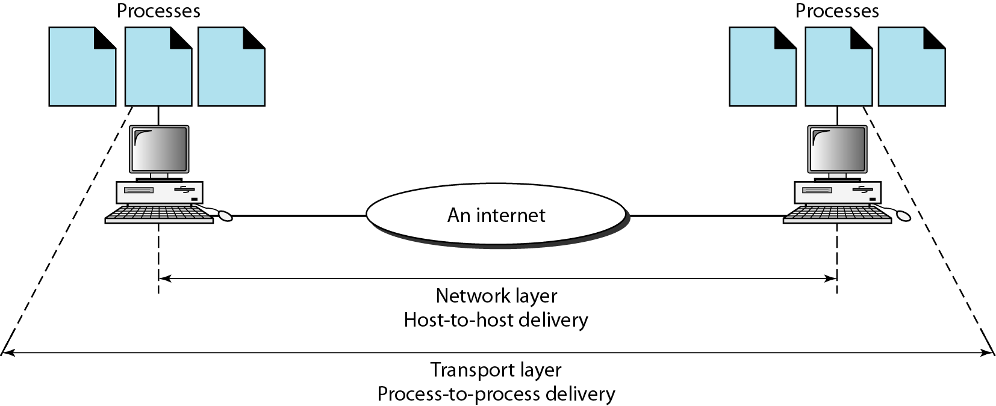
Reliable process-to-process
delivery of a message
18CSE354T – NETWORK SECURITY S - 1 / UNIT - 1

Slide 72
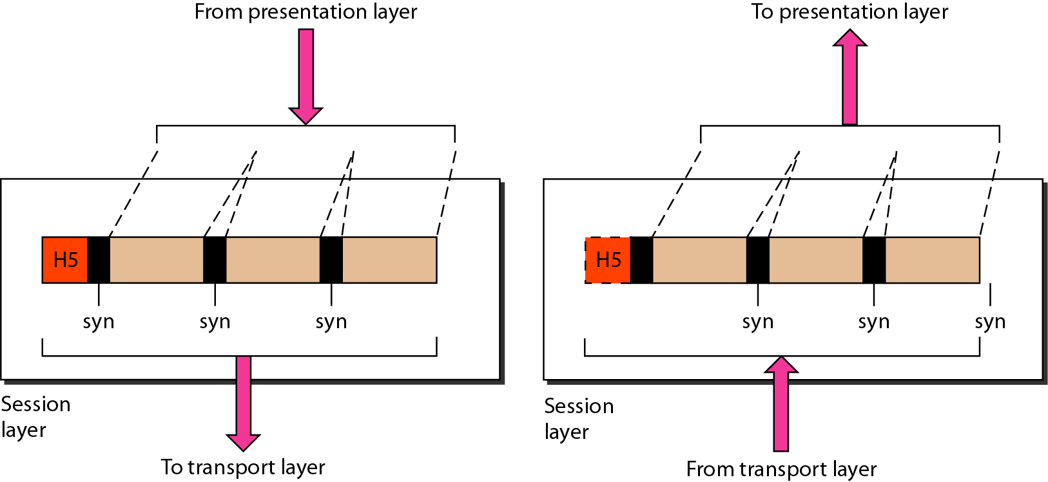
Session layer
The session layer is responsible for dialog control and synchronization.
18CSE354T – NETWORK SECURITY S - 1 / UNIT - 1

Slide 73
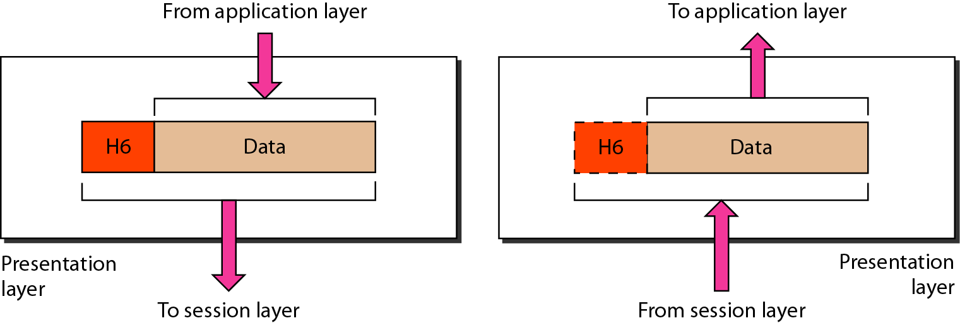
Presentation layer
The presentation layer is responsible for translation, compression, and encryption.
18CSE354T – NETWORK SECURITY S - 1 / UNIT - 1

Slide 74
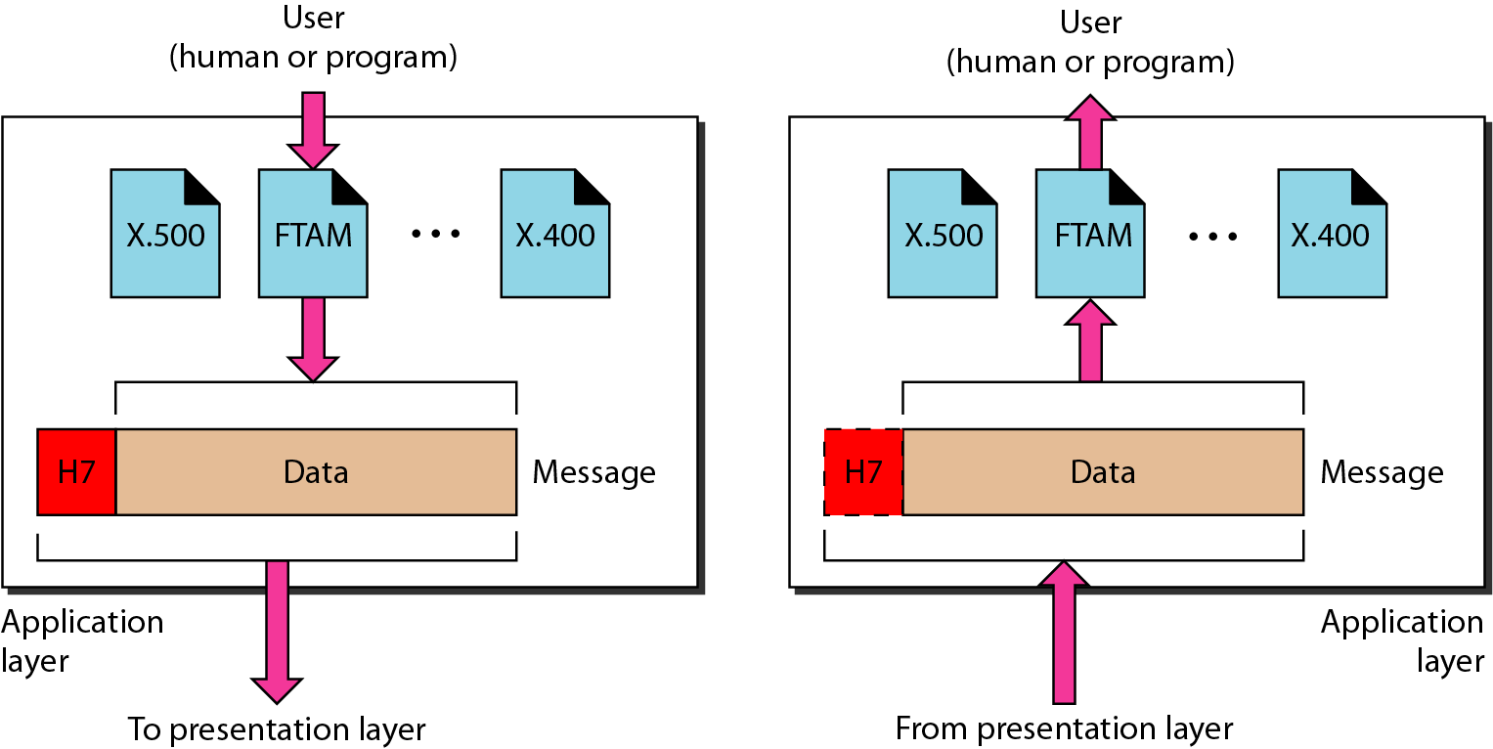
Application layer
The application layer is responsible for providing services to the user.
18CSE354T – NETWORK SECURITY S - 1 / UNIT - 1

Slide 75

Summary of layers
18CSE354T – NETWORK SECURITY S - 1 / UNIT - 1

Slide 76

TCP/IP protocol Model
The layers in the TCP/IP protocol suite do not exactly match those in the OSI model.
The original TCP/IP protocol suite was defined as having four layers:
Host-to-network
Internet
Transport, and
Application
However, when TCP/IP is compared to OSI, we can say that the TCP/IP protocol suite is made of five layers: physical, data link, network, transport, and application.
18CSE354T – NETWORK SECURITY S - 1 / UNIT - 1

Slide 77
SLO-1 & SLO-2 : Different types of network layer attacks
18CSE354T – NETWORK SECURITY S - 2 / UNIT - 1

Slide 78
Types of Attacks
Passive attacks:
A passive attack attempts to learn or make use of information from the system but does not affect system resources.
Passive Attacks are in the nature of eavesdropping on or monitoring of transmission.
The goal of the opponent is to obtain information is being transmitted. Types of Passive attacks are as following:
The release of message content
Traffic analysis
18CSE354T – NETWORK SECURITY S - 2 / UNIT - 1

Slide 79

The release of message content
Telephonic conversation, an electronic mail message or a transferred file may contain sensitive or confidential information.
We would like to prevent an opponent from learning the contents of these transmissions
18CSE354T – NETWORK SECURITY S - 2 / UNIT - 1

Slide 80
Traffic analysis
Suppose that we had a way of masking(encryption) the contents of messages or other information traffic so that opponents, even if they captured the message, could not extract the information from the message.
The opponent could determine the location and identity of communicating hosts and could observe the frequency and length of messages being exchanged.
This information might be useful in guessing the nature of the communication that was taking place.
18CSE354T – NETWORK SECURITY S - 2 / UNIT - 1

Slide 81

Traffic analysis
18CSE354T – NETWORK SECURITY S - 2 / UNIT - 1

Slide 82
Types of Attacks
Active attacks:
An active attack attempts to alter system resources or affect their operation.
Active attack involve some modification of the data stream or creation of false statement. Types of active attacks are as following:
Masquerade
Replay
Modification of messages
Denial of Service
Repudiation
18CSE354T – NETWORK SECURITY S - 2 / UNIT - 1

Slide 83

Masquerade…
Masquerade attack takes place when one entity pretends to be a different entity. A masquerade attack usually includes one of the other forms of active attack.
18CSE354T – NETWORK SECURITY S - 2 / UNIT - 1

Slide 84
Masquerade
For example, authentication sequences can be captured and replayed after a valid authentication sequence has taken place, thus enabling an authorized entity with few privileges to obtain extra privileges by impersonating an entity that has those privileges.
18CSE354T – NETWORK SECURITY S - 2 / UNIT - 1

Slide 85

Replay
Replay involves the passive capture of a data unit and its subsequent retransmission to produce an unauthorized effect
18CSE354T – NETWORK SECURITY S - 2 / UNIT - 1

Slide 86
Modification of messages
It means that some portion of a legitimate message is altered, or that messages are delayed or reordered, to produce an unauthorized effect.
For example, a message meaning “Allow John Smith to read confidential file accounts” is modified to mean “Allow Johnson to read confidential file accounts.”
18CSE354T – NETWORK SECURITY S - 2 / UNIT - 1

Slide 87

Modification of messages
18CSE354T – NETWORK SECURITY S - 2 / UNIT - 1

Slide 88

Denial of service
It prevents normal use of communication facilities. This attack may have a specific target. For example, an entity may suppress all messages directed to a particular destination.
Another form of service denial is the disruption of an entire network either by disabling the network or by overloading it by messages so as to degrade performance.
18CSE354T – NETWORK SECURITY S - 2 / UNIT - 1

Slide 89
Repudiation
This attack is done by either sender or receiver. The sender or receiver can deny later that he/she has send or receive a message. For example, customer ask his Bank “To transfer an amount to someone” and later on the sender(customer) deny that he had made such a request. This is repudiation.
18CSE354T – NETWORK SECURITY S - 2 / UNIT - 1

Slide 90
Types of network layer attacks
Eavesdropping
communications occur in an unsecured or "cleartext" format, which allows an attacker who has gained access to data paths in your network to "listen in" or interpret (read) the traffic.
When an attacker is eavesdropping on your communications, it is referred to as sniffing or snooping.
Eavesdropping is the biggest security problem that administrators face in an enterprise. Improved With strong encryption services that are based on cryptography.
Data Modification
After an attacker has read your data, the next logical step is to alter it. An attacker can modify the data in the packet without the knowledge of the sender or receiver.
Even if you do not require confidentiality for all communications, you do not want any of your messages to be modified in transit. For example, if you are exchanging purchase requisitions, you do not want the items, amounts, or billing information to be modified.
18CSE354T – NETWORK SECURITY S - 2 / UNIT - 1

Slide 91

IP Address Spoofing
Identity Spoofing (IP Address Spoofing)
Most networks and operating systems use the IP address of a computer to identify a valid entity. In certain cases, it is possible for an IP address to be falsely assumed identity spoofing. An attacker might also use special programs to construct IP packets that appear to originate from valid addresses inside the corporate intranet.
After gaining access to the network with a valid IP address, the attacker can modify, reroute, or delete your data.
18CSE354T – NETWORK SECURITY S - 2 / UNIT - 1

Slide 92

IP Address Spoofing
18CSE354T – NETWORK SECURITY S - 2 / UNIT - 1

Slide 93


IP Address Spoofing
18CSE354T – NETWORK SECURITY S - 2 / UNIT - 1

Slide 94

IP Address Spoofing
18CSE354T – NETWORK SECURITY S - 2 / UNIT - 1

Slide 95

DOS/DDOS
18CSE354T – NETWORK SECURITY S - 2 / UNIT - 1

Slide 96

DOS/DDOS
18CSE354T – NETWORK SECURITY S - 2 / UNIT - 1

Slide 97

DOS/DDOS
18CSE354T – NETWORK SECURITY S - 2 / UNIT - 1

Slide 98

DOS/DDOS
18CSE354T – NETWORK SECURITY S - 2 / UNIT - 1

Slide 99

DOS/DDOS
18CSE354T – NETWORK SECURITY S - 2 / UNIT - 1

Slide 100
Denial-of-Service Attack
Unlike a password-based attack, the denial-of-service attack prevents normal use of your computer or network by valid users.
Objective → make a service unusable, usually by overloading the server or network
After gaining access to your network, the attacker can do any of the following:
Randomize the attention of your internal Information Systems staff so that they do not see the intrusion immediately, which allows the attacker to make more attacks during the diversion.
Send invalid data to applications or network services, which causes abnormal termination or behavior of the applications or services.
Flood a computer or the entire network with traffic until a shutdown occurs because of the overload.
Block traffic, which results in a loss of access to network resources by authorized users.
Attacker usually spoofs source address to hide origin
Disrupt service by taking down hosts
E.g., ping-of-death
Consume host resources
TCP SYN floods
ICMP ECHO (ping) floods
Consume network resources
E.g., UDP/ICMP floods
Consume bandwidth
UDP floods
ICMP floods
Attacker
Lots of traffic
Victim
18CSE354T – NETWORK SECURITY S - 2 / UNIT - 1

Slide 101
Simple DoS
The Attacker usually spoofed source address to hide origin
Easy to block
Crashing the victim
Ping-of-Death
TCP options (unused, or used incorrectly)
Forcing more computation
Taking long path in processing of packets
Attacker
Victim
Victim
Victim
18CSE354T – NETWORK SECURITY S - 2 / UNIT - 1

Slide 102
Coordinated DoS
Attacker
Attacker
Attacker
Victim
Victim
Victim
The first attacker attacks a different victim to cover up the real attack
The Attacker usually spoofed source address to hide origin
Harder to deal with
18CSE354T – NETWORK SECURITY S - 2 / UNIT - 1

Slide 103
Distributed DoS
The handlers are usually very high volume servers
Easy to hide the attack packets
The agents are usually home users with DSL/Cable
Already infected and the agent installed
Very difficult to track down the attacker
How to differentiate between DDoS and Flash Crowd?
Flash Crowd → Many clients using a service legitimately
Slashdot Effect
Victoria Secret Webcast
Generally the flash crowd disappears when the network is flooded
Sources in flash crowd are clustered
Attacker
Handler
Handler
Agent
Agent
Agent
Agent
Agent
Victim
18CSE354T – NETWORK SECURITY S - 2 / UNIT - 1

Slide 104
Password - Based Attack
Password-Based Attacks
password-based access control. user name ,password.
Older applications do not always protect identity information as it is passed through the network for validation.
Eavesdropper gain access to the network by posing as a valid user.
When an attacker finds a valid user account, the attacker has the same rights as the real user..
After gaining access to your network with a valid account, an attacker can do any of the following:
Obtain lists of valid user and computer names and network information.
Modify server and network configurations, including access controls and routing tables.
Modify, reroute, or delete your data.
18CSE354T – NETWORK SECURITY S - 2 / UNIT - 1

Slide 105
Compromised Key attack and Man-in-the-Middle Attack
Compromised-Key Attack
A key is a secret code or number necessary to interpret secured information. Although obtaining a key is a difficult and resource-intensive process for an attacker, it is possible. After an attacker obtains a key, that key is referred to as a compromised key.
An attacker uses the compromised key to gain access to a secured communication without the sender or receiver being aware of the attack. With the compromised key, the attacker can decrypt or modify data, and try to use the compromised key to compute additional keys, which might allow the attacker access to other secured communications.
Man-in-the-Middle Attack
occurs when someone between you and the person with whom you are communicating is actively monitoring, capturing, and controlling your communication transparently. For example, the attacker can re-route a data exchange.
When computers are communicating at low levels of the network layer, the computers might not be able to determine with whom they are exchanging data.
Man-in-the-middle attacks are like someone assuming your identity in order to read your message. The person on the other end might believe it is you because the attacker might be actively replying as you to keep the exchange going and gain more information.
18CSE354T – NETWORK SECURITY S - 2 / UNIT - 1

Slide 106
Phishing and DNS spoofing
Sniffer Attack/ Packet Sniffer
A sniffer is an application or device that can read, monitor, and capture network data exchanges and read network packets. If the packets are not encrypted, a sniffer provides a full view of the data inside the packet. Even encapsulated (tunneled) packets can be broken open and read unless they are encrypted and the attacker does not have access to the key.
Using a sniffer, an attacker can do any of the following:
Analyze your network and gain information to eventually cause your network to crash or to become corrupted.
Read your communications.
Phishing
The fraudulent practice of sending emails purporting to be from reputable companies in order to induce individuals to reveal personal information, such as passwords and credit card numbers.
DNS spoofing
Also referred to as DNS cache poisoning, is a form of computer security hacking in which corrupt Domain Name System data is introduced into the DNS resolver’s cache, causing the name server to return an incorrect IP address.
18CSE354T – NETWORK SECURITY S - 2 / UNIT - 1

Slide 107
SLO-1: Firewall - ACL
18CSE354T – NETWORK SECURITY S - 3 / UNIT - 1

Slide 108
Components of Firewall
18CSE354T – NETWORK SECURITY S - 3 / UNIT - 1

Slide 109

Firewalls
Effective means of protecting a local system or network of systems from network-based security threats while affording(providing) access to the outside world via WAN’s or the Internet
18CSE354T – NETWORK SECURITY S - 3 / UNIT - 1

Slide 110
Firewall
A firewall is a device that filters traffic between a “protected” or inside network and a “less trustworthy” or outside network.
A firewall is basically an executable code run on a dedicated computer.
As all traffic should pass through the firewall, it is not a point of bottleneck for system performance and hence non-firewall functions are not performed on that machine running the firewall.
Also, since non-firewall code does not exist in the computer, it is hard for an attacker to make use of any vulnerability to compromise the firewall.
Internal Network
Firewall
Internet
18CSE354T – NETWORK SECURITY S - 3 / UNIT - 1

Slide 111
Static Firewall
Static Firewalls Pre-configured rulebases are used for traffic passing decisions
Default permit - the firewall allows all traffic except that which is explicitly blocked by the firewall rulebase
Default deny - the firewall denies all traffic except that which is explicitly allowed by the firewall rulebase
18CSE354T – NETWORK SECURITY S - 3 / UNIT - 1

Slide 112
Dynamic Firewalls
It also uses rulebased, but the denial and permission of any service can be established for a given time period
Stateful inspection is also a dynamic configuration
18CSE354T – NETWORK SECURITY S - 3 / UNIT - 1

Slide 113
Firewall components
Firewall are made of two components,
i. Chokes
ii. Gates
Chokes - limit the flow of packets between networks. Read packets and determine the acceptable packets, based on the rules, if the traffic should pass
Gates - act as a control point for external connections. They control the external connections.
18CSE354T – NETWORK SECURITY S - 3 / UNIT - 1

Slide 114

COMPONENTS OF A FIREWALL
18CSE354T – NETWORK SECURITY S - 3 / UNIT - 1

Slide 115
Outline
Firewall design principles
Firewall characteristics
Types of firewalls
Firewall configurations
18CSE354T – NETWORK SECURITY S - 3 / UNIT - 1

Slide 116
Firewall Design Principles
Internet & firewalls
Internet connectivity is no longer an option for most organizations
Strong security features for all workstations and servers not established (not practical)
The firewall is inserted between the premises network and the Internet to establish a controlled link
Aims of firewall
Protecting the premises network from Internet-based attacks
Providing a single choke point (where security & audit can be imposed)
18CSE354T – NETWORK SECURITY S - 3 / UNIT - 1

Slide 117
Firewall Characteristics
Design goals
All traffic from inside to outside, and vice versa, must pass through the firewall (physically blocking all access to the local network except via the firewall)
Only authorized traffic (defined by the local security police) will be allowed to pass
The firewall itself is immune to penetration (use of trusted system with a secure operating system)
18CSE354T – NETWORK SECURITY S - 3 / UNIT - 1

Slide 118
Firewall Characteristics
General techniques
Service control
Determines the types of Internet services that can be accessed, inbound or outbound (filtering with IP address & service port #, e.g. Web or email service)
Direction control
Determines the direction in which particular service requests are allowed to flow thru the firewall
User control
Controls access to a service according to which user is attempting to access it (both local users and external users)
Behavior control
Controls how particular services are used (e.g. filtering e-mail to eliminate spam)
18CSE354T – NETWORK SECURITY S - 3 / UNIT - 1

Slide 119
Firewall Characteristics
Firewall capabilities
Defines a single choke point (security capabilities are consolidated on a single system)
Provides a location for monitoring security-related events (auditing & alarming)
Provides convenient platform for some Internet functions (e.g. address translation, logging Internet usage)
Can serves as the platform for IPSec (used to implement VPN)
Firewall limitations
Cannot protect against attacks that bypass it (e.g. dial-up access)
Does not protect against internal threats
Cannot protect against the transfer of virus-infected programs or files (because various OS & applications are supported inside, it is impractical to scan all incoming files, emails, etc)
18CSE354T – NETWORK SECURITY S - 3 / UNIT - 1

Slide 120
Firewall - ACL
18CSE354T – NETWORK SECURITY S - 3 / UNIT - 1

Slide 121
Access Control List
ACLs come in two varieties:
Numbered
Named
Each of these references to ACLs supports two types of filtering:
Standard
Extended
Standard IP ACLs can filter only on the source IP address inside a packet, whereas an extended IP ACLs can filter on the source and destination IP addresses in the packet.
There are two actions an ACL can take:
permit
deny
Statements are processed top-down.
Once a match is found, no further statements are processed. Therefore, packet is permitted. If no match is found, the implicit “deny any” statement is placed at the end of the ACL and drops the packet.
An ACL should have at least one permit statement; otherwise, all traffic will be dropped because of the hidden implicit deny statement at the end of every ACL.
No matter what type of ACL you use, though, you can have only one ACL per protocol, per interface, per direction.
For example, you can have one IP ACL inbound on an interface and another IP ACL outbound on an interface, but you cannot have two inbound IP ACLs on the same interface
18CSE354T – NETWORK SECURITY S - 3 / UNIT - 1

Slide 122

How ACLs Work
Inbound (as the traffic comes into an interface)
18CSE354T – NETWORK SECURITY S - 3 / UNIT - 1

Slide 123

How ACLs Work
Outbound (before the traffic exits an interface)
18CSE354T – NETWORK SECURITY S - 3 / UNIT - 1

Slide 124
SLO-2: Packet Filtering
18CSE354T – NETWORK SECURITY S - 3 / UNIT - 1

Slide 125
Types of Firewalls
Three common types of firewalls
Packet Filtering Firewall
Application-level gateways
Circuit-level gateways
18CSE354T – NETWORK SECURITY S - 3 / UNIT - 1

Slide 126

Packet Filtering Firewall
Filtering by rules
Applies a set of rules to each IP packet and then forwards or discards the packet (in both directions)
The packet filter is typically set up as a list of rules based on matches to fields in the IP or transport (TCP or UDP) header
If a match to a rule is found, the rule is invoked
If no match is found, a default policy is taken
Default policies
Discard : Discard, if not expressly permitted (tradeoff : ease of use↓, security↑)
Forward : Forward, if not expressly prohibited (tradeoff : ease of use↑, security↓)
18CSE354T – NETWORK SECURITY S - 3 / UNIT - 1

Slide 127
Packet Filtering Firewall
Filtering rules are based on information contained in a network packet:
Source IP address: The IP address of the system that originated the IP packet (e.g., 192.178.1.1)
Destination IP address: The IP address of the system the IP packet is trying to reach (e.g., 192.168.1.2)
Source and destination transport-level address: The transport-level (e.g., TCP or UDP) port number, which defines applications such as SNMP or TELNET
IP protocol field: Defines the transport protocol
Interface: For a firewall with three or more ports, which interface of the firewall the packet came from or which interface of the firewall the packet is destined for The packet filter is typically set up as a list of rules based on matches to fields in the IP or TCP header.
18CSE354T – NETWORK SECURITY S - 3 / UNIT - 1

Slide 128
Packet Filtering Firewall
If there is a match to one of the rules, that rule is invoked to determine whether to forward or discard the packet. If there is no match to any rule, then a default action is taken. Two default policies are possible:
18CSE354T – NETWORK SECURITY S - 3 / UNIT - 1

Slide 129

Packet-Filtering Router
Example A : Inbound mail is allowed, but only to a gateway host. However, mail from host SPIGOT is blocked.
Example B : Explicit statement of the default policy.
Example C : Any inside host can send mail to the outside. The problem with this rule is that the use of port 25 for SMTP receipt is only a default. ; an outside machine could be configured to have some other application linked to port 25
18CSE354T – NETWORK SECURITY S - 3 / UNIT - 1

Slide 130


Packet-Filtering Router
Example D : This rule set achieves the intended result that was not achieved in C taking advantage of a feature of TCP connections (ACK flag of a TCP segment).
Example E : This rule set is one approach to handling FTP-like services with two connections (using control connection port and data connection port). The 3rd rule allows packets destined for a high-numbered port (nonservers) on an internal machine.
18CSE354T – NETWORK SECURITY S - 3 / UNIT - 1

Slide 131
Packet-Filtering Router
Advantages
Simplicity
Transparency to users
High speed
Disadvantages
Difficulty of dealing with applications at the packet-filtering level
Difficulty of setting up packet filter rules correctly
Lack of Authentication
18CSE354T – NETWORK SECURITY S - 3 / UNIT - 1

Slide 132
Packet-Filtering Router
Possible attacks vs. countermeasures
IP address spoofing
The attacker replaces source address of packets with an address of trusted internal host
→ Discards packets with an inside source address if the packet arrives on an external interface
Source routing attacks
The source station specifies the route that a packet should take as it crosses the Internet (in the hope that this will bypass security measures)
→ Discards all packets that use the source route option
Tiny fragment attacks
The intruder uses IP fragmentation option to create extremely small fragments and force the TCP header information into a separate packet fragment (in the hope that only the first fragment is examined and the remaining are passed thru).
→ Discards all packets where the protocol type is TCP and the IP Fragment Offset is equal to 1
18CSE354T – NETWORK SECURITY S - 3 / UNIT - 1
Notes:
IP Address Spoofing : The attacker replaces source address of packets with an address of trusted internal host.
Source Routing Attacks : The source station specifies the route that a packet should take as it crosses the Internet (in the hope that this will bypass security measures)
Tiny Fragment Attacks : The intruder uses IP fragmentation option to create extremely small fragments and force the TCP header information into a separate packet fragment (in the hope that only the first fragment is examined and the remaining are passed thru).

Slide 133
Firewalls
Packet Filters
A packet filtering firewall controls access to packets on the basis of packet address (source or destination) or specific transport protocol type (such as HTTP, Telnet, etc)
Egress filtering: Packets would be sent out (or not to be sent out) only to specific networks and/ or belonging to specific transport layer protocols.
Ingress filtering: Packets belonging to (not belonging to) only certain source networks and/ or specific transport layer protocols could be let in.
A common strategy to avoid IP spoofing attacks is to have the packet filter configured not to let in packets having a source address that corresponds to the internal network.
In other words, the attacker has spoofed the source IP address to be the IP address of a machine belonging to the network being protected by the firewall.
The code for packet filters will become lengthy as we want to block traffic belonging to specific networks, IP addresses and transport layer protocols.
18CSE354T – NETWORK SECURITY S - 3 / UNIT - 1

Slide 134
Attacks Prevented using Packet Filter Firewalls
In addition to IP spoofing attacks, packet filter firewalls could also be configured to avoid source routing and tiny fragmentation attacks.
Source routing attacks: where source specifies the route that a packet should take to bypass security measures, should discard all source routed packets
Tiny fragment attacks: intruder uses the IP fragmentation option to create extremely small fragments and force the TCP header information into fewer separate fragments to circumvent filtering rules needing full header info; can enforce minimum fragment size to include full header.
Application
Transport
Network
Link Layer
Physical Layer
End-to-End Connection
End-to-End Connection
Layers supported by Packet Filter and Stateful Firewalls
Source (adapted from): Figure 22.1(b) from William Stallings – Cryptography and Network Security, 5th Edition
18CSE354T – NETWORK SECURITY S - 3 / UNIT - 1

Slide 135





Packet Filters
Remote Network 1 (Blocked)
HTTP
Remote Network 2 (Accepted)
Packets filtered from Specific networks/ protocols
Telnet
100.50.25.x
Incoming Packets with source address spoofed to belong to Subnet 100.50.25.x are filtered
Subnet 100.50.25.x
Screening Router
18CSE354T – NETWORK SECURITY S - 3 / UNIT - 1

Slide 136
Stateful Inspection Firewalls
Firewalls based on packet filters operate on packets on an individual basis and do not store the state information pertaining to the action taken on a packet processed earlier.
Stateful firewalls (also called circuit firewalls) examine the contents of each packet with regards to their placement within the packet series belonging to a specific connection.
Stateful firewalls maintain records of all connections passing through the firewall and is able to determine whether a packet is the start of a new connection or part of an existing connection.
Stateful firewalls can remember the sequence numbers expected on both sides as part of a TCP session and can block attempts to hijack the session, when an intruder sends several TCP segments with different sequence numbers (trial-and-error).
18CSE354T – NETWORK SECURITY S - 3 / UNIT - 1

Slide 137

Stateful Inspection Firewalls
The state of a connection will be a criteria to trigger specific rules of the firewall.
Examples:
Data packets for a connection cannot get in before the connection is completely established and after a connection is completely teardown.
Do not let more than a certain number of simultaneous TCP connections to originate per IP address.
Do not let more than a specific amount of data to be transferred per day from the inside network to any outside IP address.
18CSE354T – NETWORK SECURITY S - 3 / UNIT - 1

Slide 138

Application Proxy Firewall
Packet filters look only at the headers of the packets, not at the data inside the packets.
An application layer firewall (proxy; also called as bastion) simulates the proper effects of an application so that the application receives only requests to act properly.
A proxy gateway is a two-headed device: It looks to the inside as if it is the outside (destination) connection; while to the outside, it responds as it is from the inside.
Dual-homed Proxy Firewall
Forwarded Request
Internet
Proxy Server
Application Protocol Analysis
Proxy Client
Reply
Real Server
Forwarded
Internal Network
Reply
Note: The proxy services running on such firewalls
are preferred to be independent of each other to avoid any vulnerability.
Request
Real Client
18CSE354T – NETWORK SECURITY S - 3 / UNIT - 1

Slide 139

Application Proxy
Application Proxy Firewall
Inside Connection
Application
Transport
Network
Link Layer
Physical Layer
Application
Transport
Network
Link Layer
Physical Layer
Outside Connection
Application-level Gateway
Inside Connection
Telnet
FTP
SMTP
HTTP
Outside Connection
Inside Host
Outside Host
Source (adapted from): Figure 22.1(d) from William Stallings – Cryptography and Network Security, 5th Edition
18CSE354T – NETWORK SECURITY S - 3 / UNIT - 1

Slide 140
Application Proxy Firewall
Each application proxy in the firewall requires two components: a proxy server and a proxy client.
All communication between internal users and the Internet passes through the proxy server rather than allowing users to directly communicate with servers on the Internet.
An internal user (client) sends a request to connect to an external service. The request goes through the Application Proxy Firewall that runs a proxy server for that particular service being requested.
The proxy server evaluates the request and decides to permit or deny the request based on a set of rules that are managed for the individual network service.
Proxy servers allow only those packets that comply with the services of the application protocol.
Proxy servers are also useful to collect audit records of session information
If the proxy server approves the request, it forwards that request to the proxy client.
The proxy client then contacts the real server on behalf of the real client and proceeds to relay requests from the proxy server to the real server and to relay responses from the real server to the proxy server.
The proxy server relays requests and responses between the proxy client and the real client.
Note: The above discussion assumes the client is in the internal network and the server is in the external network. The same discussion applies for the other scenario too:
The real client (from the outside network) contacts the proxy server, the proxy server evaluates the request and forwards to the proxy client, the proxy client contacts the real server (running in the internal network).
The proxy client forwards the response from the real server to the proxy server, which forwards the response to the real client (in the outside network).
18CSE354T – NETWORK SECURITY S - 3 / UNIT - 1

Slide 141

Application Proxy Firewall
18CSE354T – NETWORK SECURITY S - 3 / UNIT - 1

Slide 142
Examples of using Proxy Firewall
Scenario 1: A company wants to allow dial-in access by its employees, without exposing its company resources to login attacks from remote non-employees. Suppose the internal network has a mixture of operating system types, none of which support strong authentication through a challenge-response system.
Solution:
The requirement could be handled by a specifically written proxy that requires strong authentication such as a challenge-response, in addition to a valid username and corresponding password.
The proxy validates the challenge-response itself, and then pass on only the username and password in a form required by the internal host’s operating system.
Scenario 2: A company wants to set up an online price list so that outsiders can see the products and prices offered. It wants to be sure that (a) no outsider can change the prices or product list and (b) outsiders can access only the price list and not any of the more sensitive files stored inside.
Solution:
The requirement could be handled by a specifically written proxy that monitors the file transfer protocol data to ensure that only the price list file was accessed, and that the file could be only read, not modified.
Note: A proxy firewall can also function more as a guard, monitoring the amount and quality of data exchanged.
It could keep track of the amount of data exchanged per user from the internal network and deny access if exceeded a pre-defined limit.
A proxy firewall could also run a virus scanner to scan all the incoming files and if required outgoing files too.
18CSE354T – NETWORK SECURITY S - 3 / UNIT - 1

Slide 143
Application-Level Gateway
Advantages
More secure than packet filters
Only need to scrutinize a few allowable applications (rather than trying to deal with the numerous possible combinations that are to be allowed and forbidden at the TCP and IP level)
Easy to log and audit all incoming traffic at the application level
Disadvantages
Additional processing overhead on each connection (as the splice point, the gateway must examine and forward all traffic in both directions)
18CSE354T – NETWORK SECURITY S - 3 / UNIT - 1

Slide 144
Proxy Servers
A Proxy Server is a server (a computer system or an application program) that acts as intermediary for requests from clients seeking resources and/or service from other servers.
The proxy server typically evaluates the request according to its filtering rules (say by IP address or port number) and acts based on this evaluation.
A proxy server has a large variety of potential purposes, including:
To keep machines behind it anonymous (mainly for security)
To speed up access to resources (using caching) – Web proxy servers
To apply access policy to network services or content (to block visiting undesired sites) – proxy firewall
To log/ audit usage – proxy firewall
To scan transmitted content for malware before delivery – content-filtering web proxy
Deploying a proxy solution within a network environment is typically done either by requiring all client systems to configure their browsers to use the proxy or by deploying an intercepting proxy that actively intercepts all requests without requiring client-side configuration.
A proxy server that passes requests and replies unmodified is usually referred to as a gateway or also sometimes, tunneling proxy.
18CSE354T – NETWORK SECURITY S - 3 / UNIT - 1

Slide 145
Reverse Proxy Servers
A reverse proxy server is an Internet-facing proxy used as a front-end to control and protect access to a server/servers on a private network, as well as to perform tasks such as load-balancing, authentication and etc.
A reverse proxy server appears to the Internet clients as an ordinary server. Internally, it could merely forward the client requests to the original internal servers for handling. The response would be returned as if it came directly from the proxy server.
There are several advantages in using reverse proxy servers:
Encryption/ SSL acceleration: A reverse proxy server could accelerate the communication sessions by serving as a single “SSL proxy” to provide SSL encryption for an arbitrary number of hosts; removing the need for a separate SSL Server Certificate for each host.
Load balancing: The reverse proxy server can dynamically distribute the load to several web servers.
Security: The reverse proxy server could be an additional layer of defense and can protect against some operating system and web server specific attacks.
18CSE354T – NETWORK SECURITY S - 3 / UNIT - 1

Slide 146

Reverse Proxy Servers
18CSE354T – NETWORK SECURITY S - 3 / UNIT - 1

Slide 147
Personal Firewalls
Motivation: Home users, individual workers, and small businesses use cable modems or DSL connections with unlimited, always-on access.
These people need a firewall, but a separate firewall computer to protect a single workstation can seem too complex and expensive.
A workstation could be vulnerable to malicious code or malicious active agents (ActiveX controls or Java applets), leakage of personal data stored in the workstation, and vulnerability scans (like nmap-network map) to identify potential weaknesses.
A personal firewall is an application program that runs on a workstation to screen traffic on the workstation and block unwanted traffic leaving or entering the workstation to the network to which it is connected.
A user could configure the personal firewall to accept traffic only from certain sites, and not from specific sites, and to generate logs of activities happened in the past
A personal firewall could be also configured with a virus scanner which would be then automatically invoked to scan any incoming data to the workstation.
A static machine is a vulnerable target for the attack community and adding a personal firewall can save it more secure compared to machines that are not behind such a firewall.
18CSE354T – NETWORK SECURITY S - 3 / UNIT - 1

Slide 148

Examples for Personal Firewalls
Windows Firewall
With Windows Service Pack 2, Microsoft enabled the Windows Firewall (previously called Internet Connection Firewall) by default.
With the introduction of the Vista Operating System, Microsoft modified Windows Firewall to make it more capable and configurable to allow more granular control of network traffic and behavior analysis of applications and services.
– For example, if MS Outlook client suddenly attempts to connect to a remote web server, Windows Firewall can detect this as a deviation from normal behavior and block the unwanted traffic
.
Source: Figure 13.17 from Conklin and White – Principles of Computer Security, 2nd Edition
18CSE354T – NETWORK SECURITY S - 3 / UNIT - 1

Slide 149
Examples for Personal Firewalls
UNIX-based (Software) Firewalls
TCP Wrappers: limits inbound network connections based on port number, domain, or IP address and is managed with two text files called hosts.allow and hosts.deny.
For example, if an inbound connection request is coming from a trusted IP address (listed in hosts.allow) and destined for a port to which it is allowed to connect, then the connection is allowed.
IPchains – is a rule-based software firewall that has three configurable “chains” (set of rules) used for handling network traffic: input chain (for incoming traffic to the local system); output chain (for traffic leaving the local system) and forward chain (for traffic received by the local system; but, not destined for the local system).
Each packet passes all three chains for processing.
IPtables – uses the same three chains for policy rules and traffic handling as IPchains; but, each packet is processed only at the appropriate chain. This allows for more granular control of network traffic and enhances performance.
18CSE354T – NETWORK SECURITY S - 3 / UNIT - 1

Slide 150

Comparison of Firewall Types
18CSE354T – NETWORK SECURITY S - 3 / UNIT - 1

Slide 151
What Firewalls Can and Cannot Block
Firewalls cannot alone secure an environment.
A firewall protects only the perimeter of its environment against attacks from outsiders who want to execute code or access data on the machines in the protected environment.
Firewalls cannot protect from internal threats (through disgruntled employees).
Firewalls cannot protect against malware imported via laptop, PDA, or portable storage device infected outside the network, then attached and used internally.
Firewalls can be held responsible for any security breach in if they are the only means to control the entire network perimeter.
If a host in the inside network has a connection to the outside network through a modem, the whole of the inside network is exposed to the outside network through the modem and the host. A firewall cannot be responsible for any attack
Firewalls cannot protect data after they have left them.
A firewall is often a single point of failure for a network.
A more layered approach like a screening router, followed by a proxy firewall, followed by a personal firewall may be more helpful.
Firewalls must be frequently configured and updated to take into account the changes in the internal and external environment and based on the review of the firewall activity reports that may indicate intrusion attempts.
The machine hosting the firewall code will not have any other software like an editor, compiler, etc. in order to reduce the chances of an attack.
18CSE354T – NETWORK SECURITY S - 3 / UNIT - 1

Slide 152
SLO – 1 : Demilitarized Zone (DMZ), Alerts
18CSE354T – NETWORK SECURITY S - 4 / UNIT - 1

Slide 153
Demilitarized Zone (DMZ) Networks
A DMZ network (also called perimeter network) is a subnet that contains an organization’s services that are exposed to a larger untrusted network (like the Internet).
In other words, the DMZ comprises of hosts that provide services to users outside the internal LANs, such as e-mail, web, DNS servers.
Because of the higher chances of these hosts being compromised, they are placed into their own sub-network in order to protect the rest of the network if an intruder were to succeed in attacking them.
Thus, a DMZ network adds an additional layer of security to an organization’s LAN – an external attacker only has access to the hosts in the DMZ and not to any other internal networks.
Hosts in the DMZ provide services to both the internal and external networks – an external (“front-end”) firewall monitors the traffic between the DMZ network and the external Internet; while, an internal (“back-end”) firewall monitors the traffic between the DMZ hosts and the internal network clients.
18CSE354T – NETWORK SECURITY S - 4 / UNIT - 1

Slide 154







DMZ Networks
Front-end Firewall
Internal Protected Network
I
LAN
Switch
DMZ
Network
LAN
Switch
Back-end Firewall
18CSE354T – NETWORK SECURITY S - 4 / UNIT - 1

Slide 155

Distributed Firewalls
Note: Servers that need less protection, because they may have less critical information, could be placed in the external DMZ network
- that is even outside the external firewall.
18CSE354T – NETWORK SECURITY S - 4 / UNIT - 1

Slide 156
SLO – 2 : Audit Trials
18CSE354T – NETWORK SECURITY S - 4 / UNIT - 1

Slide 157
Alerts and Audit Trails
Firewall audits can help prove how secure a network actually is -- as opposed to how secure your customer thinks it is.
A Firewall alert pop-up appears on your computer screen when the firewall detects suspicious network traffic on your computer. There has been an intrusion attempt on your computer, and
18CSE354T – NETWORK SECURITY S - 4 / UNIT - 1

Slide 158
Alerts and Audit Trails
Cisco IOS classic firewall also generates real-time alerts and audit trails.
Enhanced audit trail features use syslog to track all network transactions;
recording time stamps
source host
destination host
ports used
the total number of transmitted bytes for advanced
session-based reporting.
Real-time alerts send syslog error messages to central management consoles upon detecting suspicious activity.
Using Cisco IOS classic firewall inspection rules, you can configure alerts and audit trail information on a per-application protocol basis.
For example, if you want to generate audit trail information for HTTP traffic, you can specify that in the Cisco IOS classic firewall rule covering HTTP inspection.
18CSE354T – NETWORK SECURITY S - 4 / UNIT - 1

Slide 159



Alerts and Audit Trails
Alerts are enabled by default and automatically display on the console line of the router If alerts have been disabled using the ip inspect alert-off command, the no form of that command, as seen above, is required to re-enable alerts.
18CSE354T – NETWORK SECURITY S - 4 / UNIT - 1
Notes:
ISCW 6.2.5-2

Slide 160

show ip inspect Parameters
18CSE354T – NETWORK SECURITY S - 4 / UNIT - 1

Slide 161

Debug ip inspect Parameters
18CSE354T – NETWORK SECURITY S - 4 / UNIT - 1

Slide 162
SLO-5 Intrusion Detection System
18CSE354T – NETWORK SECURITY S - 5 / UNIT - 1

Slide 163
FIREWALL VS IDS
Firewall cannot detect security breaches associated with traffic that does not pass through it. Only IDS is aware of traffic in the internal network
Not all access to the Internet occurs through the firewall.
Firewall does not inspect the content of the permitted traffic
Firewall is more likely to be attacked more often than IDS
IDS is capable of monitoring messages from other pieces of security infrastructure
Firewalls allow traffic only to legitimate hosts and services
Traffic to the legitimate hosts/services can have attacks
CodeReds on IIS
Solution? - Intrusion Detection Systems
18CSE354T – NETWORK SECURITY S - 5 / UNIT - 1
Notes:
Code Red was a computer worm observed on the Internet on July 15, 2001. It attacked computers running Microsoft's Internet Information Services IIS web server. ... Although the worm had been released on July 13, the largest group of infected computers was seen on July 19, 2001. On that day, the number of infected hosts reached 359,000.

Slide 164
Intrusion Detection Vs Prevention
Intrusion occurs when attacker attempts to gain entry or disrupt normal operations of information systems, almost always with intent to do harm
Intrusion detection consists of procedures and systems that identify system intrusions
Intrusion reaction encompasses actions an organization takes when intrusion is detected
Intrusion prevention consists of activities that deter intrusion
Intrusion correction activities finalize restoration of operations to a normal state and seek to identify source and method of intrusion to ensure same type of attack cannot occur again
Intrusion detection systems (IDS) Sniffs and reports possible violations. work like a burglar alarm: detect violation, activate alarm. Difference between Firewall/IDS: Can name attack
Intrusion prevention system (IPS) can detect intrusion and launch an active response. Reports violations and prevents attacks from occurring. Does inline processing, similar to a Firewall: drop packets, reset connections, route suspicious traffic for analysis. Problems: Delays in processing; bottleneck
IDS and IPS systems often coexist
Since IDS/IPS have high rate of False Positives, they require extensive optimization
Intrusion detection/prevention system (IDPS) describes current anti-intrusion technologies
18CSE354T – NETWORK SECURITY S - 5 / UNIT - 1

Slide 165

18CSE354T – NETWORK SECURITY S – 5 / UNIT - 1

Slide 166
Comparing IDS and IPS
 | Advantages | Disadvantages
 | No impact on network (latency, jitter) No network impact if there is a sensor failure No network impact if there is sensor overload | Response action cannot stop trigger packets Correct tuning required for response actions Must have a well thought-out security policy More vulnerable to network evasion techniques
IDS
 | Advantages | Disadvantages
 | Stops trigger packets Can use stream normalization techniques | Sensor issues might affect network traffic Sensor overloading impacts the network Must have a well thought-out security policy Some impact on network (latency, jitter)
IPS
18CSE354T – NETWORK SECURITY S - 5 / UNIT - 1

Slide 167
Intruders
Unknown/unwanted trespass
from benign to serious
User trespass
unauthorized logon, privilege abuse
Software trespass
virus, worm, or trojan horse
18CSE354T – NETWORK SECURITY S - 5 / UNIT - 1
Notes:
A significant security problem for networked systems is hostile/unwanted, trespass by users or software. User trespass can take the form of unauthorized logon to a machine or, in the case of an authorized user, acquisition of privileges or performance of actions beyond those that have been authorized. Software trespass can take the form of a virus, worm, or Trojan horse.. Intruder attacks range from the benign to the serious. At the benign end of the scale, there are many people who simply wish to explore internets and see what is out there. At the serious end are individuals who are attempting to read privileged data, perform unauthorized modifications to data, or disrupt the system
In an important early study of intrusion, Anderson identified three classes of intruders:
• Masquerader: An individual, likely an outsider, not authorized to use the computer and who penetrates a system's access controls to exploit a legitimate user's account.
• Misfeasor: A legitimate user, generally an insider, who accesses data, programs, or resources for which such access is not authorized, or who misuses authorized access.
• Clandestine user: An individual, either an outsider or an insider, who seizes supervisory control of the system and uses this control to evade auditing and access controls or to suppress audit collection

Slide 168
Examples of Intrusion
Remote root compromise
Web server defacement(attack on a website that changes the visual appearance of the site or a webpage.)
Guessing / cracking passwords
Copying viewing sensitive data / databases
Running a packet sniffer
Distributing pirated software
Using an unsecured modem to access net
Impersonating a user to reset password
Using an unattended workstation
18CSE354T – NETWORK SECURITY S - 5 / UNIT - 1
Notes:
[GRAN04] lists the following examples of intrusion:
• Performing a remote root compromise of an e-mail server (privilege violation)
• Defacing a Web server
• Guessing and cracking passwords
• Copying a database containing credit card numbers
• Viewing sensitive data, including payroll records and medical information, without authorization
• Running a packet sniffer on a workstation to capture usernames and passwords
• Using a permission error on an anonymous FTP server to distribute pirated software and music files
• Dialing into an unsecured modem and gaining internal network access
• Posing as an executive, calling the help desk, resetting the executive’s e-mail password, and learning the new password
• Using an unattended, logged-in workstation without permission

Slide 169
Intrusion Detection
A security service that monitors and analyzes system events for the purpose of finding, and providing real-time or near real-time warning of attempts to access system resources in an unauthorized manner.
IDS Requirement
Run continually
Be fault tolerant
Resist subversion
Impose a minimal overhead on system
Configured according to system security policies
Adapt to changes in systems and users
Scale to monitor large numbers of systems
Provide graceful degradation of service
Allow dynamic reconfiguration
18CSE354T – NETWORK SECURITY S - 5 / UNIT - 1
Notes:
The definitions shown from RFC 2828 (Internet Security Glossary) summarize the issues we are discussing.

Slide 170
IDPS Types and Options
Criteria | Type | Description
Approaches to Identifying Malicious Traffic | Signature-based | A vendor provides a customizable signature database.
 | Anomaly-based | “Normal” and “abnormal” traffic is defined.
 | Policy-based | Policy definition and description is created
 | Honeypot-based | Sacrificial host is set up to lure the attacker.
Deployment Options | Network-based | Network sensors scan traffic that is destined to many hosts.
 | Host-based | Host agent monitors all operations within an operating system.
18CSE354T – NETWORK SECURITY S - 5 / UNIT - 1

Slide 171

Intrusion Detection Systems IDS
An IDS to the networking world is like a burglar alarm to the physical world.
The main purpose of an IDS is to identify suspicious or malicious activity, note activities that deviate from normal behavior, catalog and classify the activity, and, if possible, respond to the activity.
Host-based IDS (HIDS):
It examines activities on an individual system and not concerned with other systems or the network.
Network-based IDS (NIDS):
It examines activity (traffic) crossing the network it is monitoring and not concerned about individual systems
.
Logical Depiction of IDS Components
Source: Figure 13.2 from Conklin and White – Principles of Computer Security, 2nd Edition
18CSE354T – NETWORK SECURITY S - 5/ UNIT - 1

Slide 172
Logical Components of an IDS
An intrusion detection system (IDS) is a device, typically a separate computer, that monitors activity to identify malicious or suspicious events.
An IDS typically consists of several special components (often logical and software-based rather than physical) working together on the device in which it is installed.
Traffic Collector – Collects activity/events for the IDS to examine. For a HIDS, these could be log files, audit logs, or traffic coming to or leaving a specific system. For a NIDS, these could be network traffic captured through a sniffer.
Analysis Engine – Examines the collected network traffic and compares it to known patterns of suspicious or malicious activity stored in the signature database. It is often referred to as “brain” of the IDS.
Signature Database: A collection of patterns and definitions of known suspicious or malicious activity.
User Interface and Reporting: Interfaces with the human element, providing alerts when appropriate and giving the user a means to interact with and operate the IDS.
18CSE354T – NETWORK SECURITY S - 5 / UNIT - 1

Slide 173
Signature and Anomaly-based IDS
Based on the approach adopted to detect suspicious or malicious traffic, IDS could be categorized into Signature-based and Anomaly- based IDS.
Signature-based IDS: Relies heavily on a pre-defined set of attack and traffic patterns called signatures.
A signature-based IDS (like an anti-virus software) can only match against known patterns – if a new attack comes in that the signature- based IDS has never seen before, it would not be able to identify it as suspicious or malicious – a primary weakness of signature-based IDS.
Anomaly-based IDS: Monitors activities and attempts to classify them as either “normal” or “anomalous” (suspicious and unknown) based on self-created rule sets.
An anomaly-based IDS uses heuristic techniques to categorize and classify traffic while developing and refining their internal rule sets.
An Advantage with anomaly-based IDS is that it can potentially detect new attacks or variant of old attacks.
A Drawback of anomaly-based IDS is that it could generate a potentially high number of false positives while the system is learning what “normal” is. Hence, such IDS should be programmed to dynamically adapt to changes.
18CSE354T – NETWORK SECURITY S - 5 / UNIT - 1

Slide 174
Signature-based IDS
Example for detecting an attack using signature-based IDS:
Detecting the TCP SYN flood attack using a port scan
An IDS would probably find nothing unusual in the first SYN (say to port 80) and then another SYN (from the same source address) to port 25.
But as more and more ports (especially closed ports) receive SYN packets, the pattern will reflect a possible port scan that happened already
A problem with the signature-based IDS is the signature itself: An attacker will try to modify a basic attack in such a way that it will not match the known pattern of the attack.
For example, an attacker may convert lowercase to uppercase characters, characters by the ASCII equivalents and etc.
An IDS has to learn more signature patterns to catch an attack with different patterns.
Statistical analyses are nowadays used to detect attacks with patterns that match with the stored signatures within a certain probability of error.
18CSE354T – NETWORK SECURITY S – 5 / UNIT - 1

Slide 175
Anomaly/ Heuristic-based IDS
Like the signature-based IDS, heuristic-based IDS is limited by the amount of information the system has seen (to classify actions into the right category) and how well the current actions fit into one of the categories.
Activities could be classified into three categories: Good/ Benign, Suspicious and Unknown.
Over time, specific kinds of actions can move from one category to another depending on whether the IDS learnt in due course that certain actions are acceptable or not
Model-based IDS: Develop standard models for certain activities. If the activities violated the model, raise an alarm.
Example: A normal behavior of an employee to start his day in the work environment would be to read emails, write many documents using a word processor, and occasionally backup files, etc. If an employee accesses system sensitive management utilities immediately after login, it could raise an alarm.
State-based IDS: Monitor the system as it goes through different state changes. If the rate of state change is faster than a threshold or the system has entered into previously unseen state, or the system has veered into an unsafe mode, it could raise an alarm.
Misuse-based IDS: Identify activities that could be easily misused.
Example: An attempt to access a password file is suspect, except for few utilities like login, password change, create user.
18CSE354T – NETWORK SECURITY S - 5 / UNIT - 1

Slide 176
Policy Based IDS
Policy-Based - This approach requires administrators to configure security policies according to organizational security policies and the network infrastructure. When an activity occurs that violates a security policy, an alert is triggered and sent to the system administrators
Policy-based techniques establish boundaries between the allowed and not allowed events by imposing a set of rules.
It solves two major problems: (1) detection of unknown attacks, (2) classification of normal unseen behavior into attack class. This approach is flexible.
Drawback
First, a security specialist is required to design effective policies.
Second, defined policies should be consistent and in a logically correct state throughout the system to avoid any adverse circumstances.
Policies are interrelated through their associated conditions, and, therefore, there may exist inter or intrapolicy conflicts as an incoming event may trigger more than one rule either within a policy or between two policies.
Moreover, these policies are usually implemented sequentially, and improper ordering can cause a feedback loop or deadlock situation.
However, ontology-based systems can be used to simplify the policy specification and management tasks.
18CSE354T – NETWORK SECURITY S – 5 / UNIT - 1

Slide 177
Honeypot
A honeypot is a trap to detect, deflect or in some manner counteract attempts at unauthorized use of information systems. –
A honeypot is usually a computer, and sometimes data or an unused IP address space that appears to be part of a network but which is actually isolated, unprotected and monitored, and which seems to contain information or a resource that would be of value to attackers.
Honeypots have no production value and hence should not see any legitimate traffic or activity. Whatever they capture can be surmised as malicious or unauthorized.
A honeynet is a network of honeypots. A honeynet is used for monitoring a larger and/or more diverse network in which one honeypot may not be sufficient.
A honeypot/ honeynet is more of a preventative approach of detecting potential attackers existing in the Internet who may target the organization network in the near future.
Honeypots could be used to fake as open relays to attract spam emails and determine the source e-mail address and destination e-mail addresses used by the spammers.
An open relay is an e-mail server that allows anyone on the Internet to send email through it.
Once they find an open relay, spammers keep sending the span email to the open relay and expect it to spread the spam.
Note that no ordinary e-mail will come to a honeypot. All it receives could be categorized as spam.
18CSE354T – NETWORK SECURITY S – 5 / UNIT - 1

Slide 178
Approaches to Identifying Malicious Traffic | Advantages | Disadvantages
Signature-based Detection | Easy configuration Fewer false positives Good signature design | No detection of unknown signatures Initially a lot of false positives Signatures must be created, updated, and tuned
Anomaly-based Detection | Simple and reliable Customized policies Can detect unknown attacks | Generic output Policy must be created
Policy-based Detection | Easy configuration Can detect unknown attacks | Difficult to profile typical activity in large networks Traffic profile must be constant
Honey Pot-Based Detection | Window to view attacks Distract and confuse attackers Slow down and avert attacks Collect information about attack | Dedicated honey pot server Honey pot server must not be trusted
18CSE354T – NETWORK SECURITY S - 5 / UNIT - 1

Slide 179

False Positives and False Negatives
When an IDS matches an activity to a specific pattern and generates an alarm for a non-malicious traffic that is not a threat, it is called a false positive.
Technically, the IDS is functioning correctly by matching the pattern and has no ability to determine the intent behind the activity; but, from a human standpoint, this is not an information the analyst needed to see, as it does not constitute a threat and does not require intervention.
Hostile activity that does not match an IDS signature and goes undetected is called a False negative.
Note that an IDS is limited by its signature set – it can match only activity for which it has stored patterns.
18CSE354T – NETWORK SECURITY S – 5 / UNIT - 1

Slide 180

Network-based IDS (NIDS)
NIDS are placed next to the firewall on the network perimeter and analyze the traffic as it passe by for the protocols, source, destination, content, traffic already seen and etc.
A NIDS typically looks for traffic that typify hostile actions or misuse, such as the following:
– Denial-of-service attacks, Port scans or sweeps, Malicious content in the data payload of a packet or packets, Vulnerability scanning, Trojans, Viruses, Worms, Tunneling and Brute-force attacks.
Source: Figure 13.4 from Conklin and White – Principles of Computer Security, 2nd Edition
The traffic collector of a NIDS logically attaches itself to a Network Interface Card (NIC) that operates in promiscuous mode (stealth mode) and sniffs the passing traffic.
18CSE354T – NETWORK SECURITY S – 5 / UNIT - 1

Slide 181

NIDS Placed behind Firewall
Source: Figure 13.7 from Conklin and White – Principles of Computer Security, 2nd Edition
18CSE354T – NETWORK SECURITY S - 5 / UNIT - 1

Slide 182
NIDS: Advantages and Disadvantages
Advantages of a NIDS
Less Overhead: With a few well-placed NIDSs, one can monitor the entire network traffic going in and out of the organization. Also, upgrading and maintaining a fewer number of NIDSs is usually much cheaper than upgrading and maintaining hundreds of host-based IDSs.
Big Picture: The collection of the few NIDSs can have visibility into all the network traffic and can correlate attacks (whether they are widespread or concentrated, unorganized or focused) among multiple systems.
Disadvantages of a NIDS
A NIDS is ineffective when traffic is encrypted.
A NIDS cannot see traffic that does not cross it – If a NIDS is placed only in the perimeter, chances are that it could miss traffic traversing the internal network.
A NIDS must be able to handle high volumes of traffic (even 1-Gbps is common nowadays) with the availability of networks with larger bandwidth.
A NIDS does not know about activities on the hosts themselves.
18CSE354T – NETWORK SECURITY S - 5 / UNIT - 1

Slide 183
Active vs. Passive NIDS
Passive NIDS:
A passive NIDS simply watches the traffic, analyzes it and generates alarms.
It does not interact with the traffic itself in any way, and it does not modify the defensive posture of the system to react to the traffic.
Active NIDS:
An active NIDS contains all the same components and capabilities of the passive NIDS with one critical addition – the active NIDS can react to the traffic it is analyzing.
The reactions of an active NIDS could range from something simple, such as sending a TCP reset message to interrupt a potential attack and disconnect a session, to something complex, such as dynamically modifying firewall rules to reject all traffic from specific source IP addresses for the next few hours or days.
Active NIDS are also referred to as Intrusion Prevention Systems (IPSs). When configured with the private keys of the servers in the internal network, IPSs would be able to decrypt the SSH connection establishment messages between a client and server and extract the session keys that would be used during the complete session. This gives an added advantage for the IDS/IPS to handle encrypted traffic.
18CSE354T – NETWORK SECURITY S - 5 / UNIT - 1

Slide 184
Host-based IDS (HIDS)
A host-based IDS (HIDS) examines log files, audit trails (both generated by the local operating system), and network traffic coming into or leaving a specific host.
On UNIX systems, the examined logs are those created by syslog, kernel logs and error logs; On Windows systems, the examined logs are the event logs – Application, System and Security.
Critical files are those that are vital to the system’s operation or overall functionality. They may be program (or binary) files, files containing user accounts and passwords, or even scripts to start or stop system processes.
Any unexpected modifications (for e.g., could be detected using checksum) to the critical files could mean the system has been compromised or modified by an attacker. By monitoring these critical files, the HIDS can warn users of potentially malicious activity.
Within the log files, the HIDS is looking for certain activities that typify hostile actions or misuse, such as the following:
Logins at odd hours, Login authentication failures, Additions of new user accounts, Modification or access of critical system files, Modification or removal of binary files (executables), Privilege escalation
18CSE354T – NETWORK SECURITY S - 5 / UNIT - 1

Slide 185

Host-based IDS (HIDS)
HIDS can operate in real-time, looking for activity as it occurs, or in batch mode, looking for activity on a periodic basis.
HIDS will use up some of the local system resources (like memory and CPU cycles) to operate.
The Analysis Engine of a HIDS could also use a decision tree to expedite pattern matching.
Logical Layout of a HIDS
Root Process
Log
Entry
File
Change
User
Action
Source: Figure 13.16 from Conklin and White – Principles of Computer Security, 2nd Edition
18CSE354T – NETWORK SECURITY S – 5 / UNIT - 1

Slide 186
Advantages of HIDS
A HIDS can be very operating system-specific and have more detailed signatures.
A HIDS can reduce false-positive rates.
Administrators can avoid generic alarms and develop more specific, detailed signatures to identify malicious traffic much more accurately.
A HIDS can examine data after it has been decrypted.
Encrypted traffic that is unreadable to a NIDS could be examined using a HIDS, when designed and implemented in the right manner.
A HIDS can be very application specific.
At the host level, a HIDS can be designed, modified or tuned to work very well on specific applications without having to analyze or even hold signatures for other applications that are not running on that particular system.
A HIDS can determine whether or not an alarm may impact that specific system.
Since a HIDS resides on the system, it can verify things such as patch levels, presence of certain critical files and system state while analyzing traffic. By knowing all these details, a HIDS can more accurately determine whether an activity or pattern would be potentially harmful to the system.
This can significantly reduce the number of generated alarms.
18CSE354T – NETWORK SECURITY S - 5 / UNIT - 1

Slide 187
Disadvantages of HIDS
The HIDS must be installed on every system to be protected.
The HIDS can have a high cost of ownership and maintenance. Even with a central console, with a HIDS, there will be a high number of processes to maintain, software to update, and parameters to tune.
The HIDS uses local system resources.
The resources (for e.g., CPU cycles and memory) used by a HIDS are no longer available for the host system to perform its other functions.
The HIDS has a very focused view and cannot relate to activity around it – can tell only if the system it is running on is under attack.
The HIDS, if logged locally, could be compromised or disabled.
If the HIDS stores its generated alarm traffic on the local system, an attacker who is successful in breaking into the system may be able to modify or delete those alarms. Even though the presence of an empty log file could indicate that the system was attacked, it would not be possible to conduct any sort of post-incident investigation.
Solution: It would be a better security practice to store or make a copy of the log information (at least security-related) on a separate system.
18CSE354T – NETWORK SECURITY S - 5 / UNIT - 1
Notes:
https://www.dnsstuff.com/ids-vs-ips

Slide 188

MALICIOUS SOFTWARE

Slide 189


Slide 190
Viruses and Other Malicious Content
➢computer viruses have got a lot of publicity
➢one of a family of malicious software
➢effects usually obvious
➢have figured in news reports, fiction, movies
(often exaggerated)
➢getting more attention than deserve
➢are a concern though

Slide 191


Slide 193
Back Door or Trap Doors
• secret entry point into a program
• allows those who know access bypassing usual
security procedures
• have been commonly used by developers
• a threat when left in production programs
allowing exploited by attackers
• very hard to block in O/S
• requires good s/w development & update

Slide 194
Logic Bomb
• one of oldest types of malicious software
• code embedded in legitimate program
• activated when specified conditions met
– eg presence/absence of some file
– particular date/time
– particular user
• when triggered typically damage system
– modify/delete files/disks, halt machine, etc

Slide 195

Trojan Horse
• program with hidden side‐effects
• which is usually superficially attractive
– eg game, s/w upgrade etc
• when run performs some additional tasks
– allows attacker to indirectly gain access they do not have directly
• often used to propagate a virus/worm or install a backdoor or simply to destroy data

Slide 196
Zombie
• A program that secretly takes over another internet attached computer and then uses that computer to launch attacks that are difficult to trace to the zombie’s creator.

Slide 197
Virus
The Nature of Viruses
➢ piece of software that infects programs
● modifying them to include a copy of the virus
● so it executes secretly when host program is run
➢ specific to operating system and hardware
● taking advantage of their details and weaknesses

Slide 198

Four Phases of Virus

Slide 199
Four Phases of Virus

Slide 200

Worms

Slide 201
Network Worms
Network worm uses some sort of network vehicle. Examples include:
Electronic mail facility
Remote execution capability
Remote login capability

Slide 202

The Morris Worm
Morris Worm. The Morris Worm was a self-replicating computer program (worm) written by Robert Tappan Morris, a student at Cornell University, and released from MIT on November 2, 1988. ... The worm spread by exploiting vulnerabilities in UNIX send mail, finger, and rsh/rexec as well as by guessing weak passwords.
Developer: Robert Tappan Morris
Start date: November 2, 1988

Slide 203


Slide 204
Signature Detection Change Detection State Detection
THREE METHODS TO DETECT MALWARE

Slide 205
Signature Detection
It detects the patterns or signatures in a particular program that may be malware.
When malware is suspected, it is verified against the database of known bad code fragments.
ADVANTAGE
Users and administrators can perform a simple precautionary measure keeping signature files up to date and periodically scanning for viruses.
DISADVANTAGE
The signature files may be quite large, which makes scanning slow

Slide 206
Change Detection
Finding files that have been changed is called change detection.
A file that changes unexpectedly may be due to a virus infection.
Advantages:
If a file has been infected, a change can be detected. An unknown malware, one not previously identified (zero-day), can be detected through change detection.

Slide 207
State Detection
State detection aims to detect unusual/ anomalous behavior.
It relies on an expert system that determines if a state change is anomalous.
These state changes includes malicious behavior; by extension, anomaly detection is the ability to identify potentially malicious activity.
To determine what is normal and what is unusual and to be able to distinguish between the two.

Slide 208


Slide 209


